Slide 1

Every Student Every Day Has Excellent Educators
Personnel Administrators of North Carolina - PANC
Dr. Rebecca Garland
April 2016

Slide 2
Teaching
What is teaching and has it changed for the 21st Century?
What does a teacher need to know and be able to do?

Slide 3
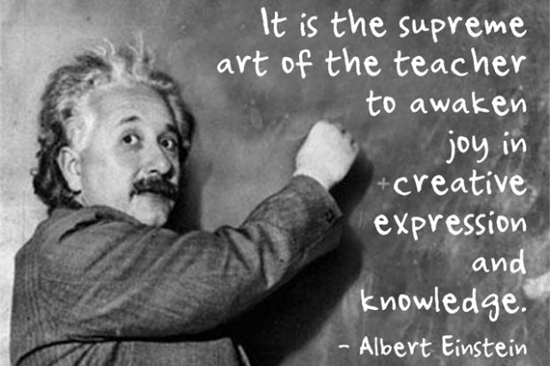
An Art
September 10, 2013 Eve Epstein

Slide 4
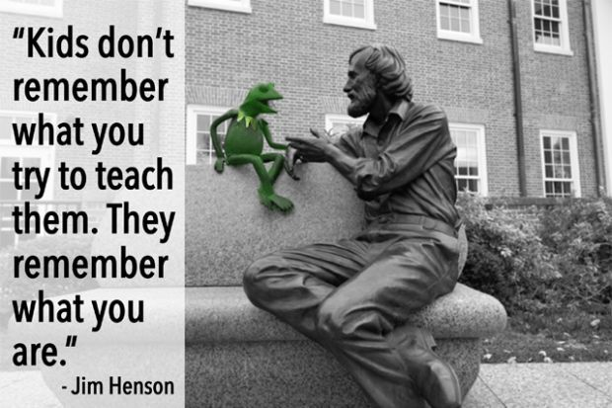
A Human Endeavor

Slide 5
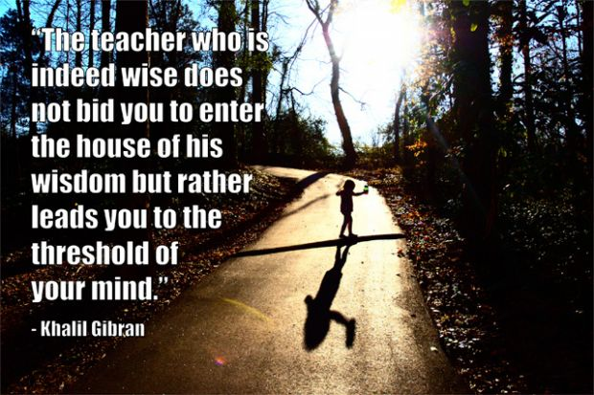
A Coach

Slide 6

A Data Analyst

Slide 7
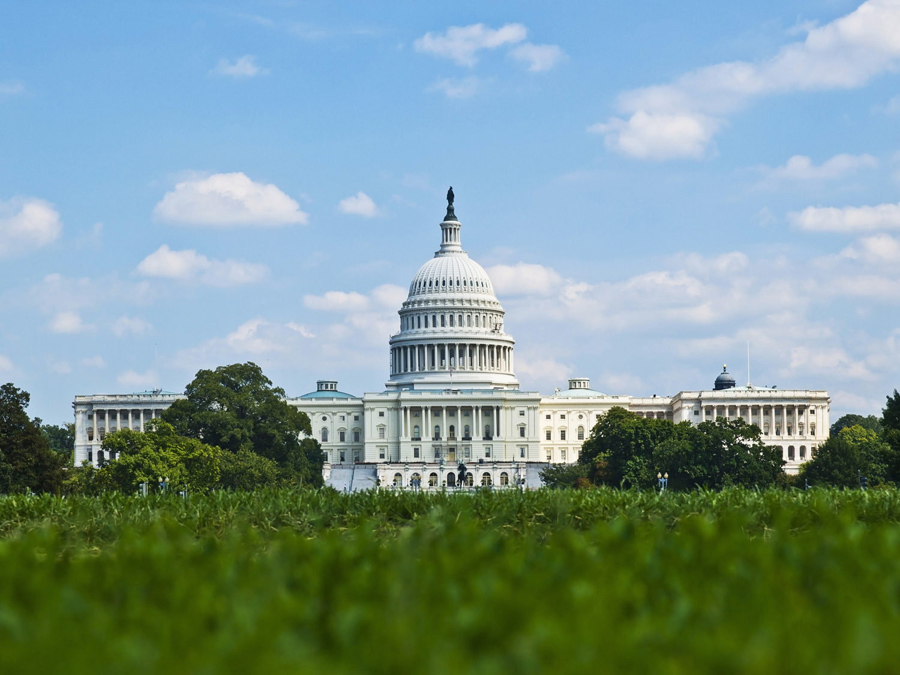

Slide 8
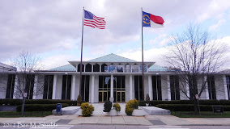

Slide 9
Policies Drive Outcomes
Legislation in 2013 to Increase Content Knowledge in
  Reading and Math for Elementary Teachers
  Technology-based Formative Assessments for Elementary Teachers
  Reading and Math for Special Education Teachers
  Re-implementation of Content Assessments for Secondary

Slide 10
2015 Legislation
Raising Standards for Educator Preparation Programs
  2.7 GPA Minimum
  1100 SAT; 24 ACT
  16 Weeks Student Teaching
  Pedagogy & Content Assessments
  Supervising Teacher – “Accomplished” & Met Growth
Offering Alternatives for Principal Preparation Programs that Focus on Student Learning and Leadership

Slide 11
A Change in the Goal
Goal in the Past:
Proficiency
Current Goal :
Career- and College- Ready
For All Students

Slide 12
Why Career and College Ready?
Students can’t read college textbooks – used to listening to teacher summaries
Students write to formulas rather than for purpose and audience
Students lack math skills
Students can’t apply knowledge
Students lack curiosity and motivation
Significant funds going to remediation

Slide 13



PROJECT
MAP
Strong Leaders
A Fair Evaluation System
Tools and Training to
Improve Practice
New Standard
Course of Study
Balanced Assessment
System
New Accountability
Model
Better Prepared Teachers
•
Support in Low-Achieving
LEAs and Schools
•

Slide 14

Interpreting the Data – The Science

Slide 15

The Data is the Canary

Slide 16
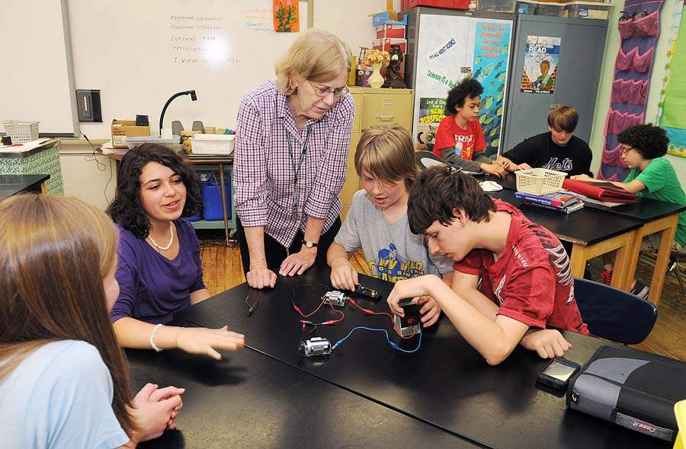
Connecting the Data to Teaching

Slide 17

The Art

Slide 18
Growth Over Time

Slide 19
Hitting the 21st Century Target

Slide 20
The Challenge
Raising Teacher Standards & Expectations During a Growing Teacher Shortage

Slide 21
Changes In Policies
2 Years to Pass Testing Requirements
Transition to Initial and Continuing Licenses
Elimination of Benchmarks Toward Clearing a Lateral Entry License
Student Growth Embedded in Standards 1-5
Student Growth Embedded in Principal Standards 1-7
All Initially Licensed Teachers, including Lateral Entry, are in Beginning Teacher Support Program

Slide 22
