Slide 1
MANAGING WORK INJURIES
IT TAKES A TEAM!
NOTE: ALL OF THE FIRST SET IS ANIMATED. DELETE THE PAGES YOU WANT AND KEEP THOSE YOU NEED.
THE DUPLICATE SLIDES BELOW ARE STATIC SLIDES.

Slide 2
Outline of Today’s Presentation:
Best Practices on date of injury;
Return to work philosophies and strategies;
Relevant hot topics in workers’ compensation claims;
Case studies.

Slide 3
Who is involved?
NOTE: THESE CAN ICONS BE REPLACED TOO IF YOU WISH.
Human Resources Professionals/Risk Managers
Supervisors
NOTE: ADD YOUR OWN IMAGES, OR SOME FROM OUR WEBSITE. TO REPLACE ANY OF THESE ANIMATED IMAGES BY RIGHT CLICKING ON TOP OF THE IMAGE THEN CHOOSING “CHANGE PICTURE” . MOVE ANY OF THEM, DELETE THEM, OR KEEP THEM. :)
BE SURE TO REPLACE THEM,
IF YOU DON’T THEY WILL NOT BE ANIMATED.
Medical Providers/Nurse Case Managers
Lawyers

Slide 4
Date of Injury Strategy
Risk Manager/HR should be contacted immediately so that incident report is completed; claim is investigated; witness statements are obtained; and treatment is directed if appropriate.
Lawyers may not need to be contacted at this early time; but if there are issues or concerns; call your lawyer for advice!
NOTE: SAME HERE…TO REPLACE ANY OF THESE ANIMATED IMAGES BY RIGHT CLICKING ON TOP OF THE IMAGE THEN CHOOSING “CHANGE PICTURE” . MOVE ANY OF THEM, DELETE THEM, OR KEEP THEM. :)
BE SURE TO REPLACE THEM,
IF YOU DON’T THEY WILL NOT BE ANIMATED.
Employees need to know to tell their supervisors/HR immediately upon the occurrence of an injury. Immediate reporting of any alleged injury/claim needs to be in employee manual.
Direct for medical treatment; have a relationship with a medical provider(s) so that you have a place to direct the employee.

Slide 5
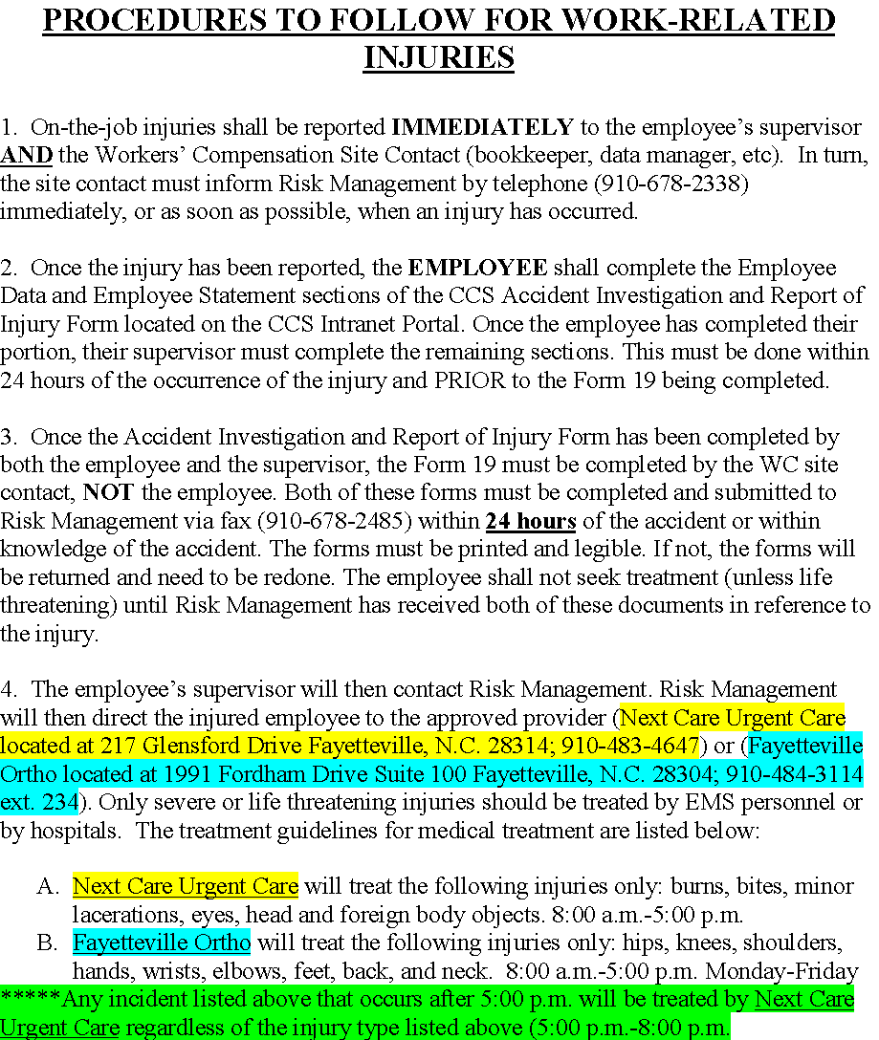

Slide 6
M-F) Also, any injury that happens over the weekend will be treated by Next
5. Injured employees do not have to pay “out of pocket” expenses for prescribed medication related to a work injury. The employee is responsible for informing the pharmacy when a prescription is related to workers’ compensation.
6. Questions related to Workers’ Compensation should be directed to Risk Management at 910-678-2338.
Please note:
Employees insisting on medical treatment from a doctor of their own choice, especially outside the approved provider, should be informed of the following:
The Workers’ Compensation Act (97-25) states that the employer (Cumberland County Schools) shall direct the injured employee to the physician of the employer’s choice.
Failure to comply with the employer’s direction may result in denied payment for medical expenses incurred for unauthorized treatment.
Note to Sites:
All injuries must be IMMEDIATELY reported to the supervisor AND the Workers’ Compensation Site Contact even if no medical treatment is required. For non-medical injuries, the form 19 report will kept on file and forwarded to CCS Risk Management.

Slide 7
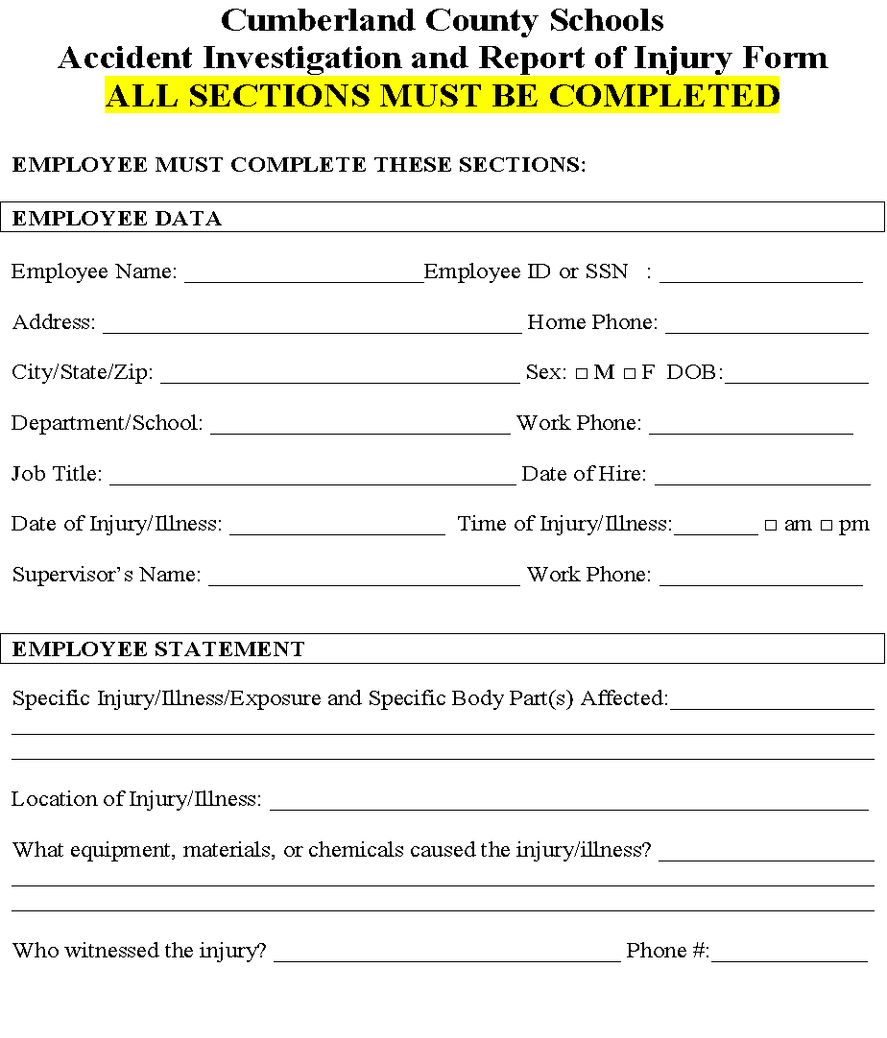

Slide 8
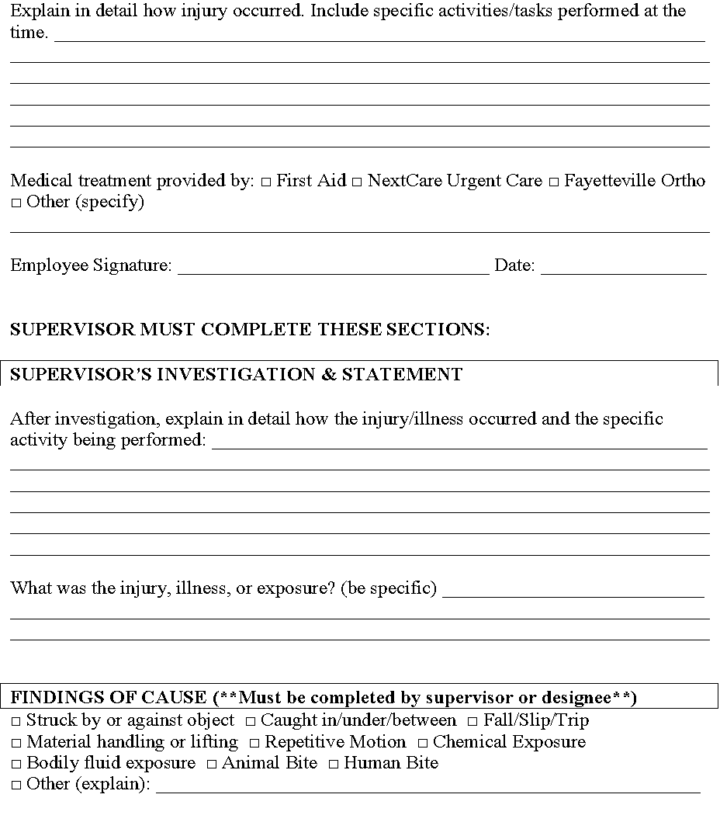

Slide 9
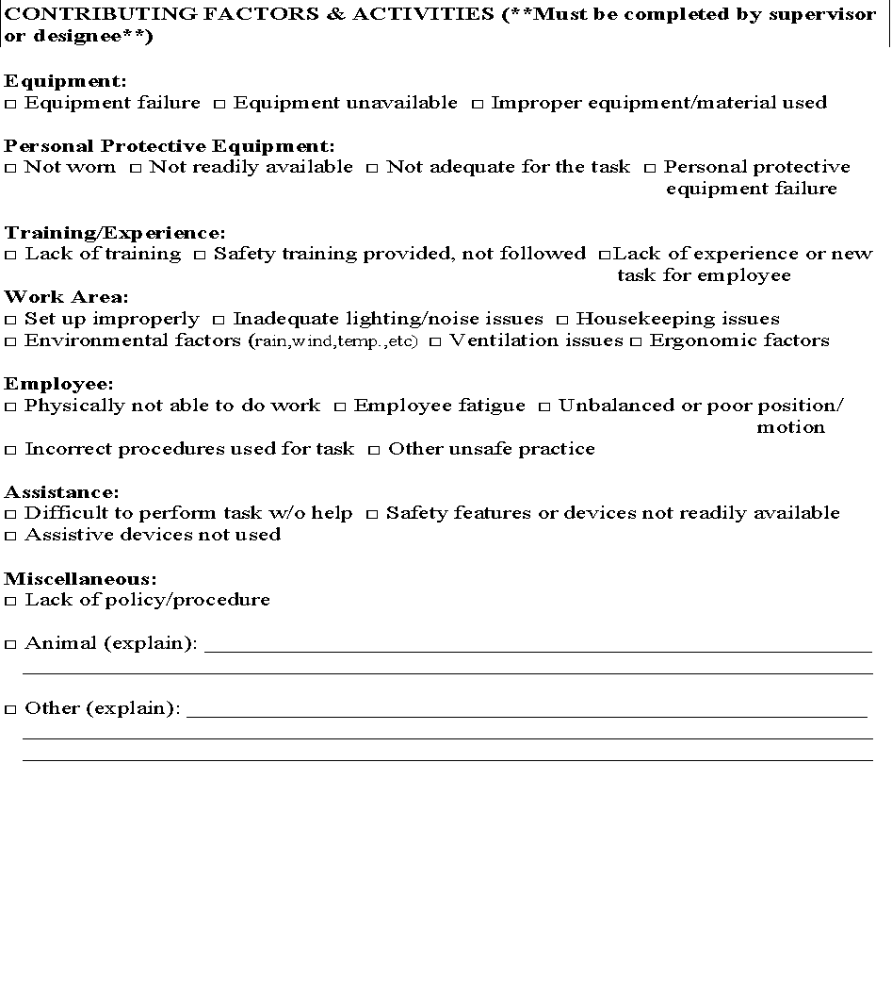

Slide 10
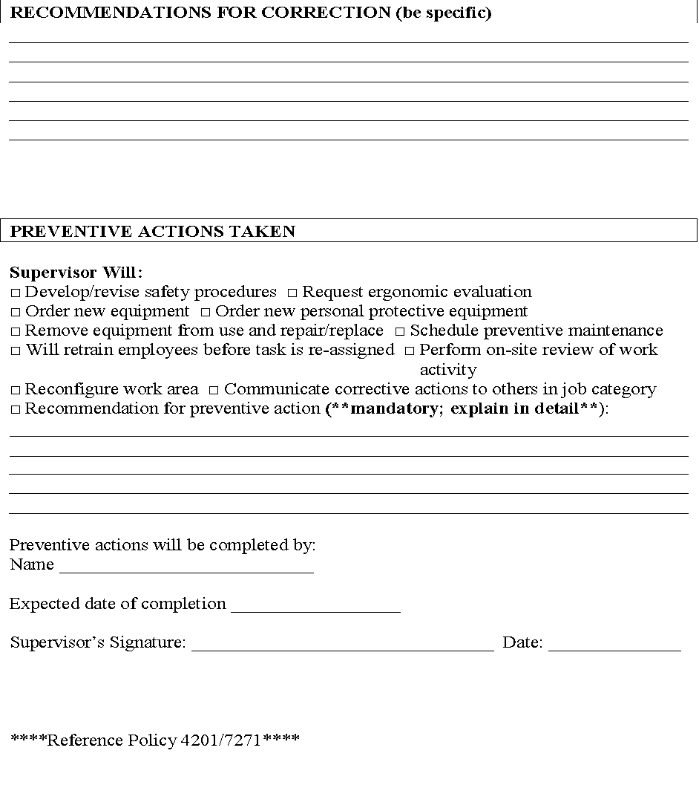

Slide 11
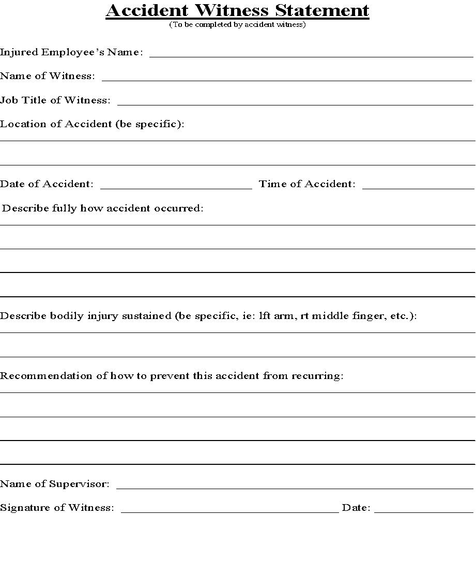

Slide 12
NAVIGATING MEDICAL TREATMENT
Have a designated provider for initial treatment;
Partner with medical providers – consistency is key;
Consider a Nurse Case Manager in certain cases;
Ensure medical provider believes and understands transitional duty;
Provide employee/employee’s attorney with medical records as soon as they are received.
The right provider is critical to your program!

Slide 13
NOW BACK TO WORK!
NOTE: THESE PEOPLE CAN BE REPLACED IF YOU WISH AS WELL AS THE ICONS.
Date of Injury
Investigation/Accident Report
Direct Medical Care
Provider provides light duty work restrictions
Return to the supervisor/HR
HR/Supervisor RTW
Work Restrictions
Direct Care
Investigate
Report

Slide 14
RTW BENEFITS!
Increases self-esteem and reduces chance of re-injury!
Saves Money (indemnity; length of time out of work)
Encourages teamwork!
Enhances Recovery!
Increases morale among entire workforce!

Slide 15
Establishing a Return to Work Program
Conduct a job analysis for each job title to include tasks and physical requirements. Also, look at loss data to return trends (ladders, slippery floors, etc.)
Ensure excellent communication between HR, Supervisors, Employees in departments regarding the transitional position (do not push Employee past limits!)
Make sure there is a culture of communication and teamwork throughout this process; remain consistent and positive!
Use medical provider with similar return to work philosophy, and put system into place to obtain provider approval of light duty jobs

Slide 16
MODIFIED DUTY ASSIGNMENT

Slide 17
EXAMPLE OF LETTER TO EMPLOYEE:

Slide 18
MODIFIED DUTY ASSIGNMENT

Slide 19
Other Relevant Topics for Discussion
Medicare considerations
Global Settlements (Resignation and Release Agreements) and Settlement Language
Safety Policy/Safety Commitment Form

Slide 20
Medicare Considerations
Medicare knows about almost every settlement with a Medicare beneficiary (reporting);
Every settlement has two considerations: past and future medical expenses.
Past medical expenses (ie: Medicare conditional payments): bigger concern in denied or partially denied claims;
Future medical expenses (Medicare Set Asides): generally bigger concern in accepted claims since we are generally not funding future medical expenses in denied settlements

Slide 21
Medicare Considerations
All parties have an interest in ensuring Medicare’s interest are appropriately protected;
The conditional payment repayment process is extensive so start early;
CMS will agree to review Medicare Set Asides in certain threshold cases, but the review process is not mandatory; and
Medicare Advantage Plans are also providing coverage to approximately 1/3 of Medicare beneficiaries so be aware of these liens as well.

Slide 22
Settlements
Global settlements can be done
However, some rights cannot be waived in a General Release
Fair Labor Standards Act (wage and overtime)
Unemployment
EEOC charges
Vested benefits; Cobra rights
Settlement language is extremely important
Mediated Settlement Agreements
Clincher language
Any terms need to spelled out
Pro se clinchers

Slide 23
Sample Release/Resignation Language

Slide 24
Safety Policy/NCIC Submission
N.C. Gen. Stat. § 97-12 provides that compensation shall be reduced by 10% if the injury or death is caused by willful breach of “Any rule or regulation adopted by the employer and approved by The Commission and brought to the knowledge of the employee prior to the injury.”
Submit safety policy to NCIC and request approval.
Ensure we can demonstrate that the employee was aware of the safety policy.
Benefits: give employees incentive to be safe; and potential credit on rating.

Slide 25
Safety Commitment Form
Employer Safety Manual
Crisis Management and Emergency Handbook
DPI policies Governing Services for Children with Disabilities
Bus Driver Handbook
Reporting of Accidents
Board Policy 4201-7271**********
Accident Investigation and Correction of Hazards
Preventive and Corrective Measures
Reporting Hazards
Employee Responsibility for Safety
Site Assessments

Slide 26
Safety Commitment Form
Texting and Driving while the vehicle is in motion.
Alcohol and Drug Policy
Appropriate PPE
Exit Paths and Work Surfaces
Aisles and Passageways
Wet floor signs/Clean up Spills
Chemical Safety Section Compliance
Lock-out/Tag-out
Ladder Section/Safety Manual
No Climbing in Chairs or standing on Tables
Horseplay
Comply with IEP and BIP. Implement BIP when encountering aggressive students.

Slide 27
Safety Commitment Form
Results:
Emphasis on Safety for workers
Reduced employee injuries by 85 for 2015-16 fiscal year
A more productive work force
6457 Employee Signatures

Slide 28
Employee Safety Commitment Google Form
Results:
Emphasis on Safety for workers
Reduced employee injuries by 85 for 2015-16 fiscal year
A more productive work force
6457 Employee Signatures

Slide 29
CASE STUDY #1
Wilma, a custodian, gets written up for insubordination, and a strong warning
Wilma’s husband calls the principal on a Sunday afternoon saying Wilma is in the ER due to a work injury
Surveillance shows no fall and no injury
Surveillance also shows a violation of policy
What do you do?

Slide 30
Investigate Prior to Accepting Claim
Very suspicious circumstances so consider a denial (Form 61);
Plaintiff can accept denial or challenge it by filing a Form 33, Request for Hearing;
The Industrial Commission will refer the case to mediation if Plaintiff is represented;
Weigh risks and exposure, and decide to settle or litigate.

Slide 31
CASE STUDY #2
Lucy the art teacher falls and injures both knees
Provider agrees to modified duty, signs off on modified job description – 3 locations
Three years later Lucy has ongoing pain
Provider says for her to work at only one location
Funding for her position requires work at 3 locations
What do you do?

Slide 32
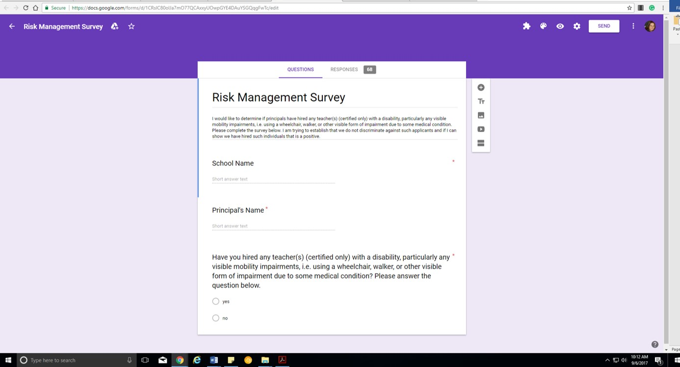

Slide 33
CASE STUDY #3
Ava, an EC teacher, has her arm jerked, causing neck injury, and requires surgery
Ava is released to work with very limited, sedentary restrictions
How do you return Ava back to work?

Slide 34
The “cost” of returning Ava to work, vs. the “cost” of ongoing TTD
Scenario 1: Remains out of work
TTD is ongoing until Plaintiff returns to suitable employment (which may be difficult given her restrictions);
Compensation rate = $366.69, which puts her yearly payout at $19,067.88.
Indemnity paid over 500 weeks totals $183,345 (discounted at 6%: $139,255.71).
Scenario 2: Returns to work
Return to work in a light duty capacity - TTD is stopped;
She either successfully returns to work;
Value: No TTD; may have to pay Temporary Partial Disability (TPD), but only if wages are reduced as a result of the work injury.
Or makes a decision to resign at some point.
If there is a resignation, consider global resolution of her workers’ compensation claim;
Assuming she was working in a suitable job and voluntary resigns, there will be little to no consideration of TTD in the settlement (instead it will be medical + any rating (a 20% rating of the neck is worth 60 weeks or $22,001.40).

Slide 35
The “cost” of returning Ava to work, vs. the “cost” of ongoing TTD
In other words:
$22,001.40 + medicals
VERSUS
$183,345 + medicals
Potentially a savings of $161,343.60 on the workers’ compensation claim due to return to work.

Slide 36
CASE STUDY #4
Linda is a cafeteria assistant and suffers a shoulder injury, requiring surgery
Employee written out of work beyond the last day of school
Employee receives TTD through summer
Frozen shoulder develops and her work restrictions are no lifting over 1 pound
What do you do?

Slide 37
Costs savings considering a $233.35 CR?
10% rating to arm ($5,600.40) plus medicals
VERSUS
Ongoing TTD for 500 weeks ($116,675) plus medicals
Savings = $111,074.60

Slide 38
Case Study #5 – Grand Finale
John had a work-related disc replacement;
Out of work, and reaches MMI with permanent restrictions;
County doesn’t accommodate so he stays out of work, collecting TTD;
Co-workers learn of him engaging in activities not consistent with disability;
New risk manager/attorney = new philosophy
Case goes away!

Slide 39
What would have happened, and what did happen (CR $233.35)?
He was receiving annual compensation at a rate of $12,134.20. He was approximately 25 years old so had a lifetime expectancy of 52 years. No cap on benefits during that time period.
Had he continued to stay out of work, there was a possibility of paying over $630,968 in TTD benefits assuming he lived out his life expectancy.
Instead, he was offered a job, refused, and resolved his case for $50,000.

Slide 40
The Self-Insured Retention (SIR) Spin vs. The Excess Insurance Spin

Slide 41
Your Self-Insured WC Program Retention Spin
POLICY PERIOD | Self-Insured Retention SIR | Number of Claims Piercing the Retention
2007 | $350,000 | 0
2008 | $350,000 | 0
2009 | $350,000 | 1
2010 | $350,000 | 0
2011 | $400,000 | 0
2012 | $400,000 | 0
2013 | $450,000 | 0
2014 | $475,000 | 0
2015 | $500,000/400,000 buy down | 0
2016 | $500,000/400,000 | 0
2017 | $500,000/400,000 | 0

Slide 42
SIR Considerations…
RTW Policy/Medical Provider Understanding
Claims Management/Closing Rates
Loss Control/Prevention/Safety Commitment Form/Safety Committee
Claims history/Actuarial Study/history and patterns…
Adequate Financial Risk Transfer Program
Protected SIR-control with staff/TPA
Small Deductible/Insurance –”In the middle”
Stay Fully Insured?
Experiencing Modification Factor less than 1.00 Credit Mod
Quality Legal Counsel
Talk to someone who can give you the viability of SIR Programs…
Broker
Independent Consultant

Slide 43
THANK YOU FROM ALL OF US AT HEDRICK GARDNER, AND CUMBERLAND COUNTY SCHOOLS!
Erica Lewis, Partner, Hedrick Gardner Kincheloe & Garofalo, Wilmington, elewis@hedrickgardner.com, 910-679-4802
Erin Collins, Partner, Hedrick Gardner Kincheloe & Garofalo, Wilmington, ecollins@hedrickgardner.com, 910-679-4812
Henry Smith, Cumberland County Schools, Fayetteville, henrysmith@ccs.k12.nc.us, 910-678-2591

