Slide 1
Ins and Outs of Assessing Salaries
Personnel Administrators of NC
Spring Conference
Presented by
Hank Hurd, MBA/CPA, SEC Partner
Kathy Isenhour, CPA, SEC Partner
Ricky Lopes, CPA, SEC Partner
Brenda Jones, Consultant

Slide 2
Discussion Questions
What categories of employees need a critical look in your district?
Discuss ways to garner support for conducting a salary study in your district.
Other than salaries, what are some ways to boost morale of employees?
How can PANC leverage its members to support salary increases?

Slide 3
About Us
SEC-School Efficiency Consultants
Financial Wellness Evaluations
Cost Containment Studies
Resource Management Training
Financial and Efficiency Reviews
New Program Implementation Cost Studies
Internal Control System Analysis, Implementation, and Monitoring
Risk Management Assessments
Salary Allocation Utilization and Analysis
Operational Expense Analysis

Slide 4
About Us
Worked in More Than 60 Districts
Conducted Studies in NC, SC, VA, MS, and AL
3 SEC Partners Who Are CPAs, Experienced School Finance/Operations Leaders
Staffed by Multiple Consultants With Expertise in Curriculum, HR, and More
Goal to Help Districts Operate More Effectively and Efficiently

Slide 5
SEC’s Experiences
Central Office Salary Comparisons for Key Positions
Central Office Organization Restructuring Options
Operational Efficiency Studies for Specific Areas (ex. Transportation, HR, Finance, etc.)
Classified Salary Studies Comparing to Market Survey Data

Slide 6
SEC’s Experiences
Engaged by Superintendent/Board to Conduct Central Office Reorganization When New Superintendent Came on Board
Hired to Conduct Specific Position Comparisons for Selected Districts (Classified and Certified)
Studied Finance and Human Resources Organizations to Help Improve Communications/Efficiency

Slide 7
NC School Personnel
94.4% of State Funds in 2015-16 Used for Salaries and Benefits
65.5% of State Funds Allocated as Guaranteed Certified Positions
7.3% of Total Personnel Paid from Federal Funds in 2015-16

Slide 8
NC Salaries
In a Nutshell:
STAGNANT

Slide 9
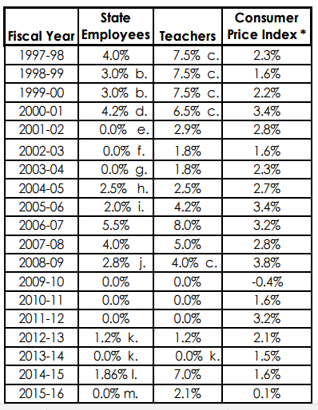
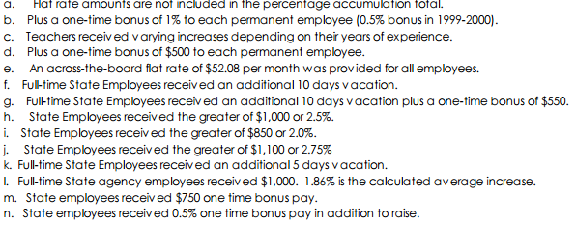
NC Salaries: Compensation Increases

Slide 10
NC Salaries: Compensation Increases
2013-14
0 (Teachers)
0 (State Emp)
2014-15
7.0 (Teachers)
1.86 (State Emp)
2015-16
2.1 (Teachers)
0 (State Emp)

Slide 11
Principal Turnover Rate: 2014 Report
NC Principals Stay at Same School Average of 2.7 to 3.5 Years
States With Highest Principal Turnover Rates:
North Carolina
Rhode Island
Alaska
California
Oregon
New Mexico
Delaware
Nevada
Idaho

Slide 12
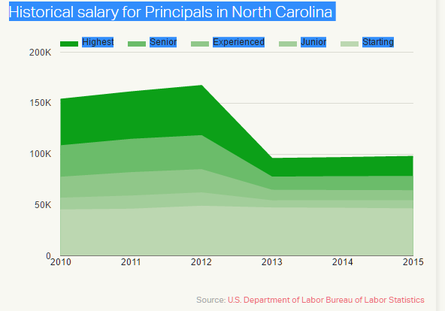
NC Salaries: Compensation Increases

Slide 13
NC Salaries: Principals
#1: New Jersey: $127,780
#21: Virginia: $88,470
#35: South Carolina: $81,660
#48: Mississippi: $72,790
#50: North Carolina: $63,720
Difference Between #1 and #50: $64,060!

Slide 14
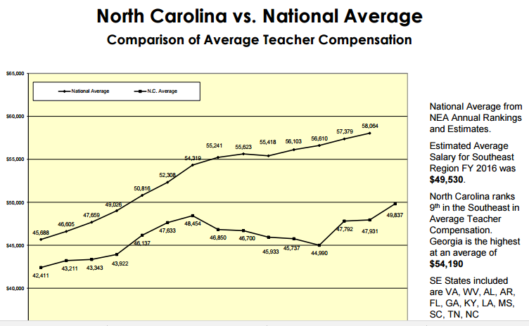
NC Salaries: Teachers

Slide 15
Attract and Retain Employees
Percentage of Employers Who Said Retention of Employees was Important:
2010: 20%
2015: 63%
Ways to Lower Turnover:
Set the Right Compensation and Benefits
Review Compensation and Benefits Packages at Least Annually

Slide 16
Salary Survey/Study
Private Industries Conduct Salary Studies Routinely
School Districts Sometimes Go Years or Never Conduct Salary/Compensation Studies
Even Without the Funds to Implement, Great Value to Conducting Study

Slide 17
Why Conduct
Goal
Build Competitive Pay Structure for Your School District
Key Reasons for Conducting Salary Study
To Ensure Salaries Are:
Internally Equitable
Externally Competitive

Slide 18
Transparency
Millennials:
Document Their Lives on Facebook and Other Social Media
They Share Information Regarding Compensation
View Is Knowledge Is Power
Use This Information to Negotiate Higher Salaries
(Source: Wall Street Journal)

Slide 19
Value
Signals to Employees that the Issue is Important
Assures that Job Descriptions Will be Updated
Starts Conversations about Benefits and What’s Important
Identifies Needs and Provides Justification for Changes

Slide 20
Planning for a Study
Review Historical Reports
Determine Positions Previously Reviewed/Reclassified
Update Job Descriptions
Reach Consensus on Positions to Include
Review Compensation/Benefits Policies
Determine Cohort Criteria
Determine Level of Detail Desired in Study

Slide 21
Planning for a Study
Cohort Criteria:
Districts of Similar Size
Geographical Area
In-State or Mix
Competitors
Other

Slide 22
Planning for a Study
Who Does What
HR Dept Provides:
Salaries
Organization Charts
Updated Job Descriptions
Supplement Information

Slide 23
Planning for a Study
Who Does What
SEC:
Gathers Data
Verifies Data
Prepares Analysis
Determines Recommendations
Provides Phase-in Options

Slide 24
Typical Study Components
Survey to Gather Salaries
Verification of Apples to Apples Comparisons
Review of Regional Labor Market Salary Data for Positions (Classified Staff)
Analysis of Salaries
Recommendations for Changes and Implementation
Check, Check, and Recheck!

Slide 25
Example
Principal/AP/Teacher Supplements:
Principal supplements are low compared to the average and should be increased. Plus, there should be differences based on size of school. High school principal supplements, in particular, should be addressed immediately. The average for all principals, differentiated by levels, should be increased to $11,500.
Assistant principal supplements also are low and should be increased to an average of $4,700.
Teacher supplements are low compared to the other districts. SEC recommends raising the teacher supplement to at least $3,000. It is optimistic to aim for the state average but an increase to $3,000 would make the district more competitive with surrounding districts and the market survey group.

Slide 26
Example

Slide 27
Example
Implementation Costs:
Directors: Dependent on the change in pay grade level.
Principals: The approximate cost to raise the average principal supplement to $11,500 is $180,000.
Assistant principals: The approximate cost to raise the average AP supplement to $4,700 is $62,000.
Teachers: The cost to raise the teacher supplement to $3,000 is approximately $1.2 million at current benefit rates.
HVAC Tech: The cost to change the HVAC Tech from PG 66 to PG 67 is approximately $7,850 based on the average salary.
Phase-In Suggestions:
Principals: This action should be taken as soon as possible.
Teachers: SEC recommends phasing in the teacher supplement increase over a three-year period at a cost of approximately $420,000 per year at current benefit rates.

Slide 28
Discussion Questions
What categories of employees need a critical look in your district?
Discuss ways to garner support for conducting a salary study in your district.
Other than salaries, what are some ways to boost morale of employees?
How can PANC leverage its members to support salary increases?

Slide 29
About Us
www.secrives.com
H. Hank Hurd, CPA, Partner
hhurd@secrives.com
919-698-5449

