Slide 1
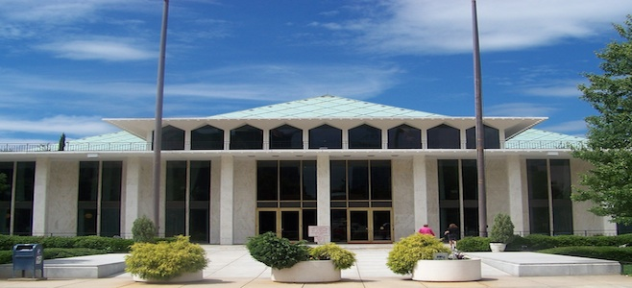
2017 Session Update
Katherine Joyce, Executive Director
www.ncasa.net | 919-828-1426 | kjoyce@ncasa.net

Slide 2
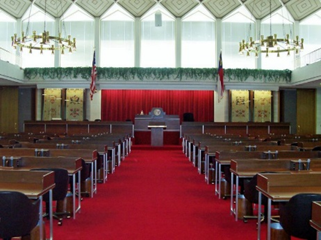
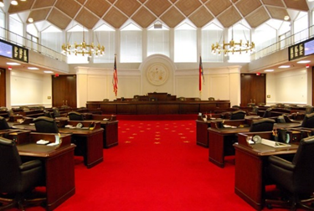
2017 Session Landscape
House
74 Republicans
46 Democrats
Speaker of the House: Rep. Tim Moore (R-Cleveland)
Senate
35 Republicans
15 Democrats
President Pro Tem: Sen. Phil Berger (R-Rockingham)

Slide 3
NCASA Priority: Enhanced Investment in North Carolina Public Schools
Increase the state’s per-student investment
Restore the previous K-3 class size exceptions and district averages
Invest in professional development
Increase technology funding
Prevent additional cuts to school personnel in all aspects of school operations, including TA’s and central office.
Ensure appropriate public school voices are heard on Funding Formula Task Force

Slide 4
K-3 Classroom Teacher Ratio
Funded Teacher Allotment
Kindergarten: 1:18
1st Grade: 1:16
2nd & 3rd Grade: 1:17
Current Law: Allows for flexibility over funded allotment
District Average: 1:21
Individual Class Size: 1:24
2016 Budget Law: To take effect 2017-2018 school year
District Average: Must be at funded allotment ratio
Individual Class Size: No more than 3 over funded allotment ratio
H13 – Modifies allowable district average and individual class size for grades K-3
District Average: No more than 3 over funded allotment ratio
Individual Class Size: No more than 6 over funded allotment ratio

Slide 5
Funding & Allotments
H6 – Creates the Joint Legislative Task Force on Education Finance Reform, charged with reviewing current public school allotment system and studying weighted student formula models, or allotment reformations
H305 – Repeals statutory authority for LEAs to sue county commissioners over sufficiency of funds
Legislation to study this issue passed in 2016. Findings not yet reported
S75 – Moves to amend the NC Constitution to provide a cap on state income tax at 5.5%. Potentially problematic because:
Limits ability to raise revenue for student population growth
Limits ability of future General Assemblies to respond to unexpected fiscal challenges
Turning to sales tax is a more volatile revenue source

Slide 6
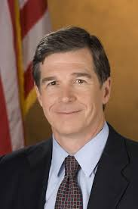
Governor’s Budget
ADM – $29.4M for student enrollment growth
More Personnel To Improve Outcomes – $20M to LEAs to hire additional personnel who will have direct impact on student outcomes
Textbooks & Digital Resources – $3M in recurring and $10M in non-recurring funds
Advanced Teaching Roles Pilot – $9.8M in non-recurring funds for 10 LEA pilot program
Digital Learning – Professional Development – $5M
Digital Learning – Home Base Content & Support – 1.2M
Transforming Low-Performing Schools – $10M for coaching and planning for school personnel in low-performing schools

Slide 7
NCASA Priority: Competitive Compensation For All School Personnel
Improve principal pay from 50th lowest; reconnect to teacher salary schedule.
Provide salary increases to all school personnel in 2017.
Move North Carolina teachers closer to the national average.
Ensure robust benefits package for public school employees.

Slide 8
Compensation & Benefits
S234 – Using Lottery funds:
Provides a block grant of 7% over avg. principal salary for LEAs to determine how to pay principals; 1-yr hold harmless
Provides one-time $2,600 bonus
Creates new principal bonus program awarding qualifying principals with up to 5 one-time $1,000 bonuses for a total of up to an additional $5,000.
Provides 13% increase tied to teacher "A" scale for assistant principals
Creates a new capital fund for the State's neediest counties
S169 – Expands bonus eligibility in last year’s budget to certain 3rd Grade and AP/IB teachers who earned bonuses but who were otherwise ineligible
H24 – Establishes Joint Committee to Study Unfunded Liability of the Retiree Health Benefit Fund

Slide 9
Governor’s Budget
Teacher Pay – $271M to provide avg 5% increase in year one; $542M to provide another avg 5% increase in year two
SBA Pay – $20M for avg 6.5% increase (including step)
Other LEA and School Personnel – $50.5M for 2% salary increase or $800 increase, whichever is higher; $26.7M for one-time $500 bonus for permanent employees
State Retirement Contribution – $6.4M for increase in State’s retirement contribution
One-Time COLA – $38.4M for one-time COLA increase
State Health Plan – $46.9M for increase in SHP funding
Instructional Supplies Stipend – $14M for a $150 stipend for each teacher to buy classroom supplies

Slide 10
NCASA Priority: Calendar Flexibility
Provide LEAs with school calendar flexibility to meet local needs
Allow public school calendars to align with those of nearby community colleges and universities
Ensure that all first semester End-of-Course exams can be administered before the winter break

Slide 11
Calendar Flexibility
Local Bills – 52 local calendar flexibility bills have been filed in the General Assembly this session (as of 3/24)
13 in the Senate
39 in the House
H53 – Statewide bill that allows school to begin no earlier than August 10
H375 – Statewide bill that allows LEAs to align their start date with the start date of their local community college, but no earlier than August 15
H389 – Pilot legislation allowing for 20 LEAs to begin school no earlier than August 10
S318/S321 – Grants calendar flexibility to schools and LEAs identified as low-performing

Slide 12
NCASA Priority: School Performance Grades & Accountability
Provide school districts with one cohesive accountability system that meets both federal and state objectives
Increase the weighting of student growth from 20% to 50%
Remove all schools that “meet growth” standards from the definition of and penalties for low-performing schools
Provide additional resources to schools and districts designated as low-performing

Slide 13
Accountability
H322 – Increases the weight of school growth in calculation of A-F school performances grades to 50%.
Current school performance grades calculation based on 80% achievement and 20% growth
Maintains 15-point scale for next 2 years
Would then revert to 10-point scale barring further action by the General Assembly
H458 – Modifies School Performance Grade system to provide for separate grades for achievement and growth
H90 – Eliminates NC Final Exam and the student work process as instrument to evaluate teachers
Uses school-wide growth for teachers who teach less than 60% of their time teaching EOG or EOC subjects

Slide 14
NCASA Priority: Accountability In School Choice Options
Maintain fair funding of traditional public schools and charter schools.
Limit state expansion of vouchers, ASD, virtual charter schools, and any other initiative sending public tax dollars to private, for-profit entities.
Require every educational entity receiving state funds to be held accountable under the same standards governing traditional public schools.

Slide 15
School Choice
S159/S254 – Allows a home, private, or charter school student to participate in athletics or other extracurricular activities at an LEA high school if not offered at their school
S291 – Allows home or private school students to enroll in North Carolina Virtual Public School courses and be charged at the same rate as public school students

Slide 16
Teacher Issues
H339/S252 – Establishes new Teaching Fellows program aimed at STEM and Special Education licensure areas
H235 – Expands eligibility for mentor teachers by lowering the criteria from "accomplished" to "proficient" and allowing for retired teachers to serve as teacher mentors
H155 – Expands activities qualifying for continuing licensure of retired teachers, and allows for LEAs to hire retired principals, APs, and teachers to serve as interim principals

Slide 17
Student Safety Issues
S55 – Authorizes counties to adopt ordinances providing for civil penalties for passing a stopped school bus
H116 – Requires the SBE and LEAs to educate participants involved in school athletics on sudden cardiac arrest and heat-related illnesses.
Requires coaches to be CPR certified
H117 – Requires criminal background checks for teacher licensure and school personnel employment
H285 – Directs the SBE to develop a youth suicide awareness and prevention training program and a model risk referral protocol for LEAs to provide to school personnel who work directly with students in grades 6through 12.
LEAs to provide to personnel within 12 months of employment and every 5 year thereafter

Slide 18
State Health Plan
The SHP Board of Trustees has approved the following changes, effective January 1, 2018:
Eliminate the CDHP 85/15 plan offering.
Reduce number of wellness premiums/credits from three to one, by retaining only the tobacco attestation requirement on the 70/30 and 80/20 plans.
Subscribers who are not tobacco users or enroll in a Plan-approved tobacco cessation program will receive a $60 credit toward their monthly premium.
Charge the following subscriber monthly premiums:
70/30 Plan = $25.00
80/20 Plan = $50.00
Freeze premium rates for the family coverage tier on 70/30 and 80/20 plans at the 2017 level.
Discontinue enrollment in the Stork Rewards Program March 31, 2017, to phase out by end of 2017.

Slide 19
Member Resources
Executive Director Katherine Joyce
kjoyce@ncasa.net
Assistant Executive Director Anne Strickland
astrickland@ncasa.net
Finance Manager
Elizabeth Martini
emartini@ncasa.net
Executive Assistant
Rhonda Jernigan
rjernigan@ncasa.net
Government Affairs Specialist
Adam Pridemore
arpridemore@ncasa.net
Contract Lobbyist
Bryan Holloway
NCASA Office (new as of 9/6/2016)
107 Glenwood Avenue
Raleigh, NC 27603
Phone: 919-828-1426
info@ncasa.net
www.ncasa.net
www.ncasalegislativelink.org
@NCASATweets

