Slide 1

Data-Driven. People-Powered.™
The TeacherMatch 360 System

Slide 2


About TeacherMatch
®
Founded by a group of dedicated, passionate educators with a wealth of experience, who understand that highly talented leaders, teachers, and support staff are the most critical factor in:
Fostering whole student development
Delivering measurable academic growth and achievement
Advancing district/school performance and reputation
Notes:
At TeacherMatch we get it….Teachers matter most…..

Slide 3

Our Story . . . Founded By a Team of K-12 Leaders Interested In Solving Three Problems:
The need for a valid, research-based instrument backed by universities to screen teacher candidates for success in the classroom
A tool that helps new teacher induction succeed with a personalized PD pathway that identifies a teacher’s strengths and opportunities for growth
A system to provide an innovative, new way to advance, streamline, and facilitate talent management recruiting and hiring
Notes:
TeacherMatch was founded by a group of educators and academics who were frustrated by three problems in K12.
The first problem was the lack of a researched based instrument to help identify teachers who were most likely to be effective at delivering meaningful academic growth to students. The founders realized the single most important decision a school system will make are the teachers it hires. So TeacherMatch was formed as a research consortium to answer the following question:
WHAT IS THE LIKELIHOOD THAT A TEACHER CANDIDATE WILL BE EFFECTIVE AT ACHIEVING ACTUAL STUDENT GROWTH?
The founders of TeacherMatch also believed that if you could truly understand who was likely to be effective at delivering academic growth you could also understand where a teacher was likely to succeed and struggle in the classroom. And by understanding the strengths and weaknesses of a new teacher you could then develop a meaningful, data-driven, customized induction program to help new teachers succeed.
The third problem the founders were trying to solve was a seamless way to effect candidate recruiting, screening, hiring and on-boarding on one platform – given the complexity of these tasks – they felt one system was key to helping HR departments facilitate hiring the best teachers in an efficient and effective manner.
It is these three fundamental problems that led to the formation of TeacherMatch

Slide 4
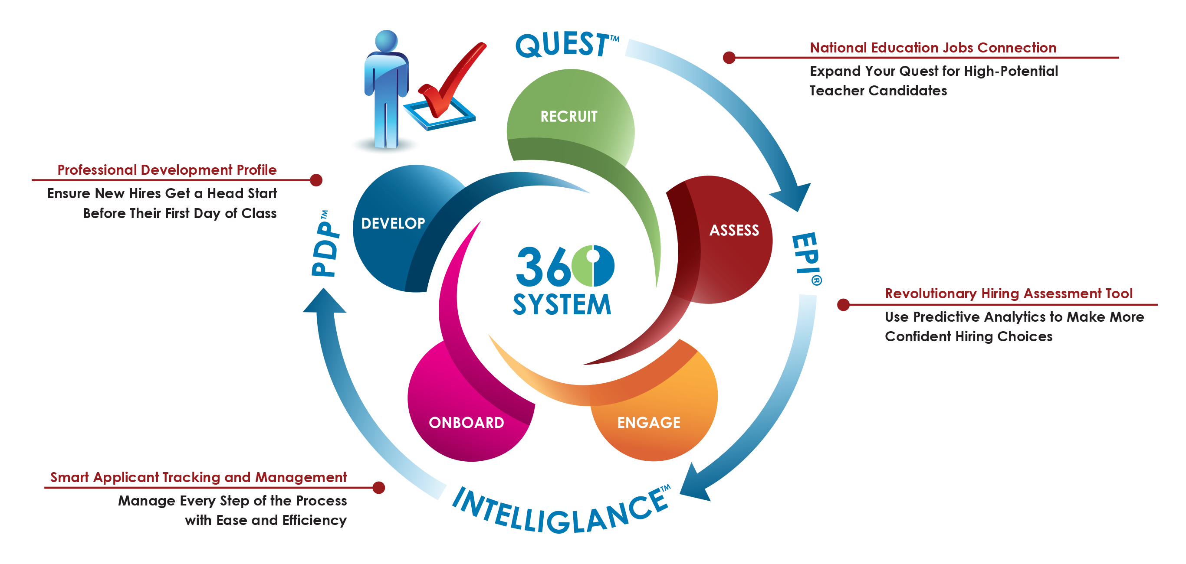
The Result: An Advanced Education Talent Management System . . . TeacherMatch 360
Notes:
Given the problems the founders resolved to tackle, I am really excited to walk you through our platform, the TeacherMatch 360 system!
Our QUEST system helps you identify and recruit the greatest amount of candidates
The Educators Professional Inventory (or EPI) helps you assess those candidates and determine which ones will be most effective in the classroom.
The IntelliGlance Applicant Tracking system enables you to facilitate hiring those candidates in a way that is customized to the way you do business.
And finally the Professional Development Profile enables you to customize new teacher induction based on their actual strengths and weaknesses.

Slide 5

The IntelliGlance system is designed to help districts…
Notes:
The TeacherMatch system is designed to help districts:
Recruit – using our National Quest Job Board, a district’s branded job board, and even branded job boards for each school, TeacherMatch helps you cast a wide net to pool a diverse, quality group of candidates for your positions.
Select – IntelliGlance’s suite of selection tools and features make the process simple for determining the best candidates, measured against the criteria you set. Add candidate questions per job category, include scale scores for hiring manager review steps, and communicate with candidates via IntelliGlance’s auto and as-needed messages that you customize and deploy.
Onboard – IntelliGlance’s Onboarding feature is designed to (1) improve communication between HR teams, hiring managers, and candidates (2) track key milestones for the new employee process and (3) improve efficiency and streamline associated paper processes.

Slide 6

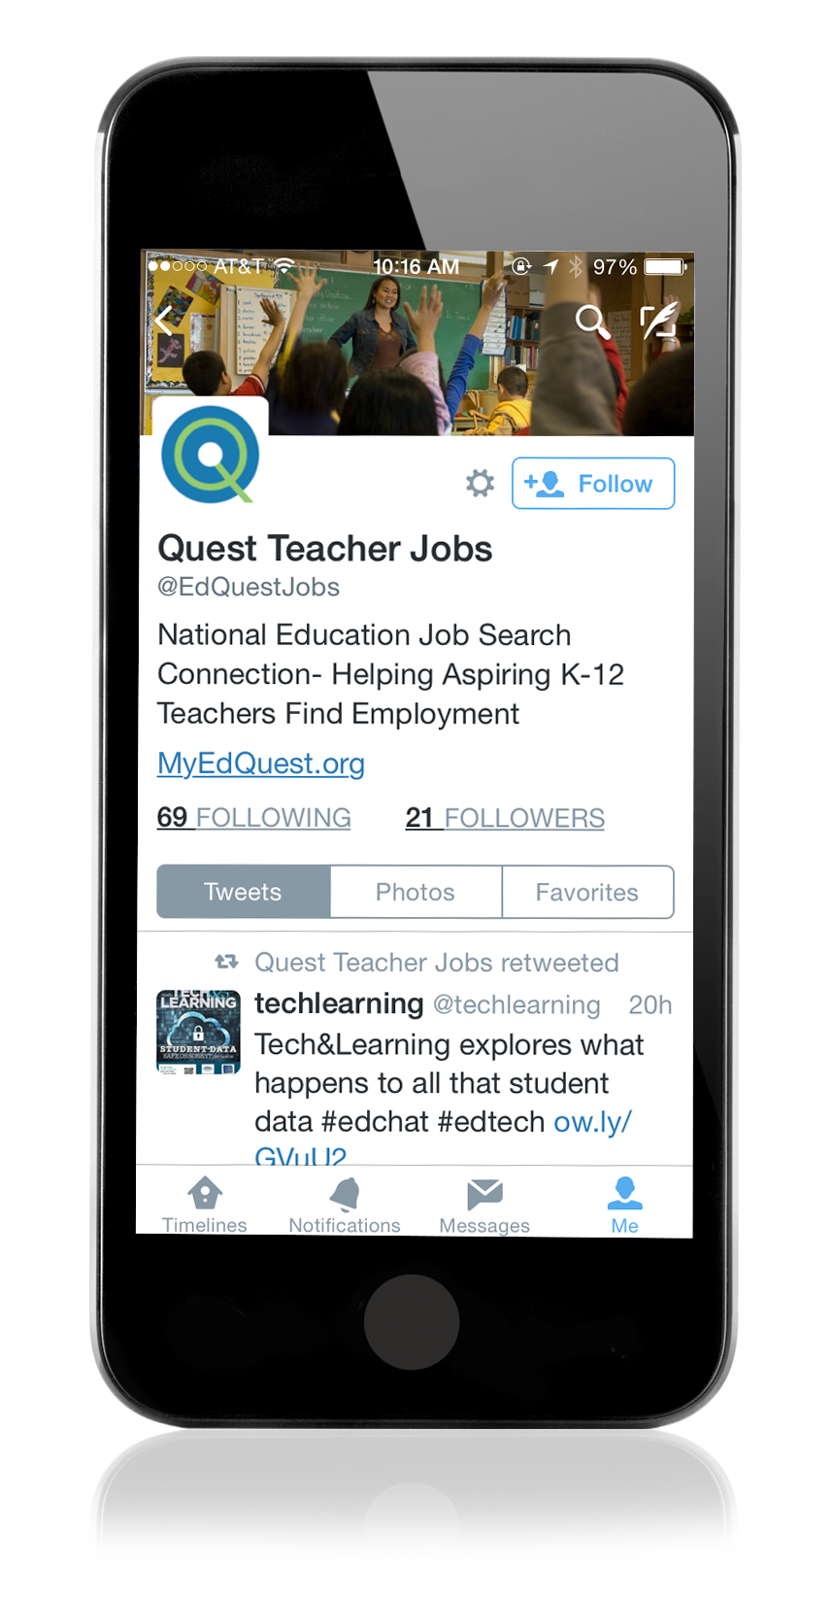
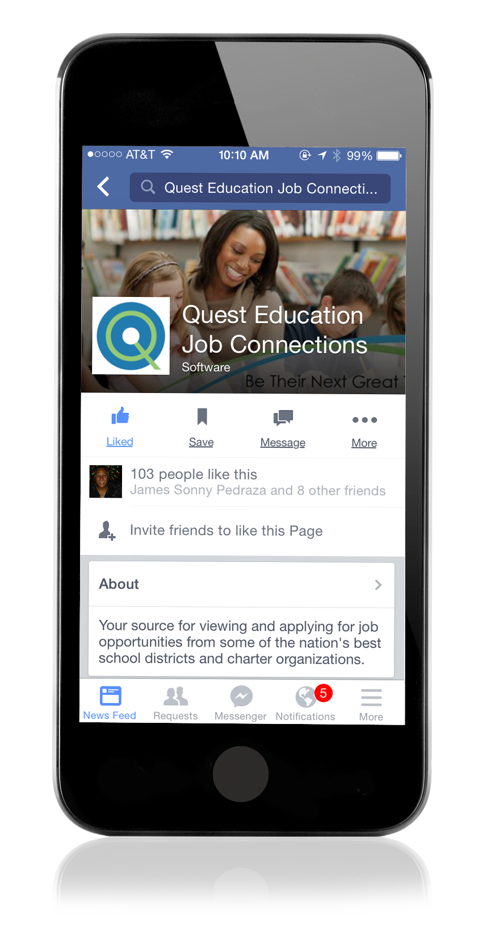
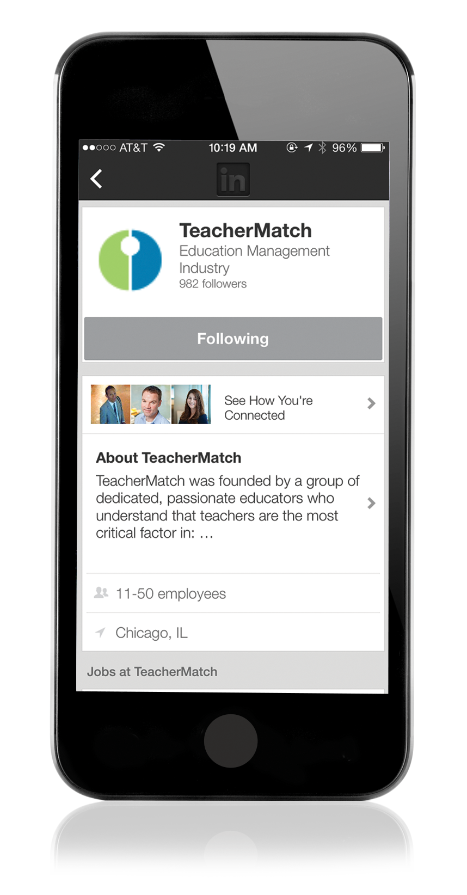



Collaborating with NCDPI and You to Expand Your Reach. . .
We use advanced tools and analytics — including the power of
social media to help you find the ideal candidate.
Notes:
Let me walk you through our platform starting with Quest – this tool helps ensure all of your job postings get maximum exposure!
Every time you create a job posting on our platform the system automatically:
Posts the position on your customized district job board enabled by the system
A national job board that is partnered with schools of education across the country
Exposure on potential candidates Facebook and LinkedIn feeds
And full integration with Twitter and Google+ ……all seamlessly and automatically ensuring maximum exposure resulting in the greatest quantity of candidates applying!

Slide 7

Our Strong Collaboration with NCDPI and You Offer. . .
A truly different approach to applicant tracking:
Provides an innovative, new way to streamline and facilitate talent management via a true end-to-end solution designed for the challenges of K-12
Enables you to identify and recruit top talent
Provides insights via a click of the mouse
Makes communication with stakeholders seamless
Notes:
We realized early on that the best recruiting system or screening tool is only as effective as the platform it is built on – this lead us to develop Intelliglance…a truly different, integrated, seamless applicant tracking system that:
Enables you to manage every aspect of your hiring process, from prospecting for new candidates to facilitating their on-boarding paperwork (health insurance, direct deposit forms….)
Provides you instant access to those candidates who are most promising – enabling you and your principals to schedule their interviews with a click of the mouse…
Configures over 1,800 different ways –I’ll show you how momentarily
And finally solves for a major pain point, the ability to automatically communicate with all of your applicants throughout your hiring process in a way that feels personal – yet requires no manual intervention!

Slide 8
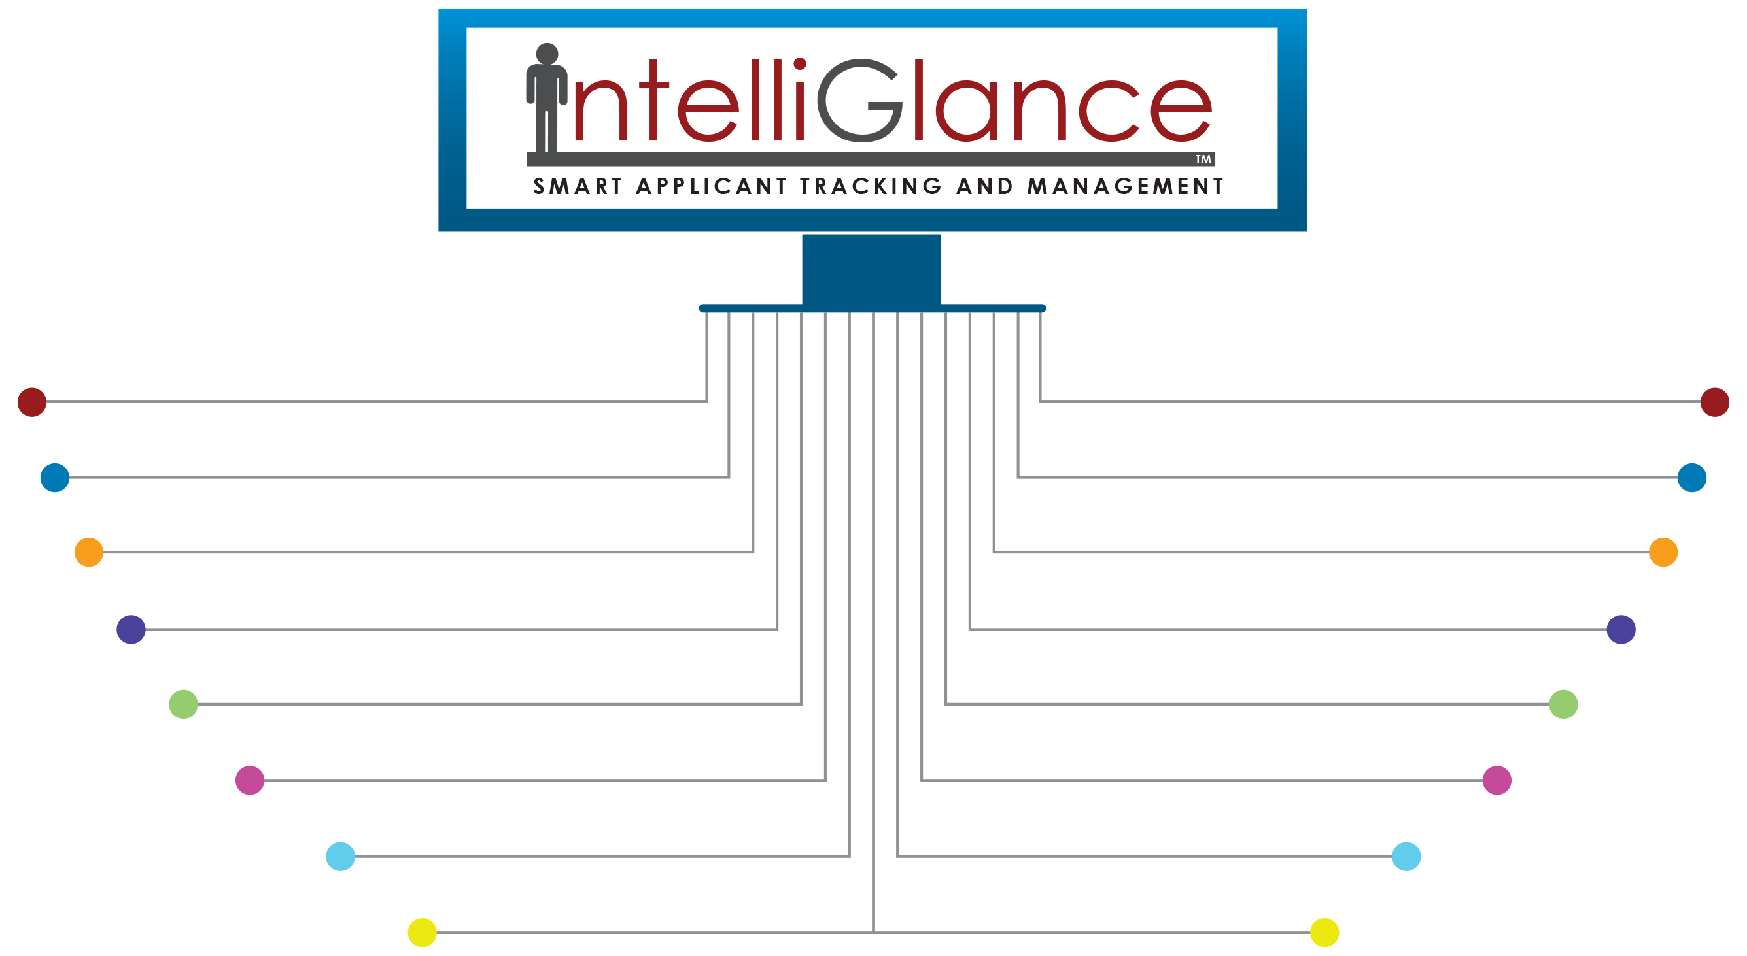
So Many Customized Advanced Features. . .
An ecosystem that saves time and increases productivity!
eReferences
Self-Service Tools
Video Interviewing
HRIS Integration
Event Management
Actionable Analytics
Paperless Onboarding
Instant Email Integration
Quest Jobs Connection
Real-Time Action Feed
EZ Application Form
District Performance Indicators
Pop-Up Candidate Profile
Fully Automated Communications
Candidate Planning Folder
Collaborative Workflow Process
Notes:
With IntelliGlance, you get a powerful applicant tracking and management ecosystem that’s designed to help make your entire hiring and onboarding process less time-consuming, more efficient and productive – and easier to manage and maintain for your users and teacher candidates alike.

Slide 9
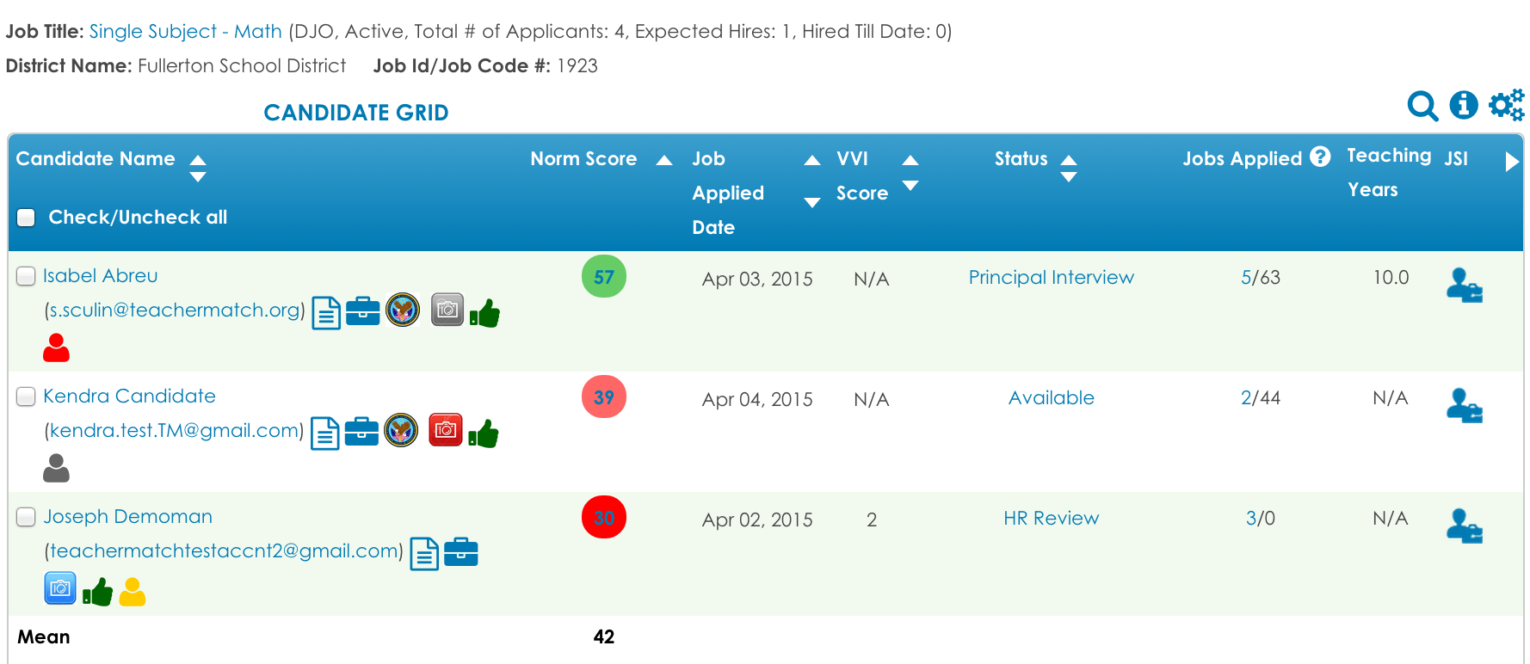
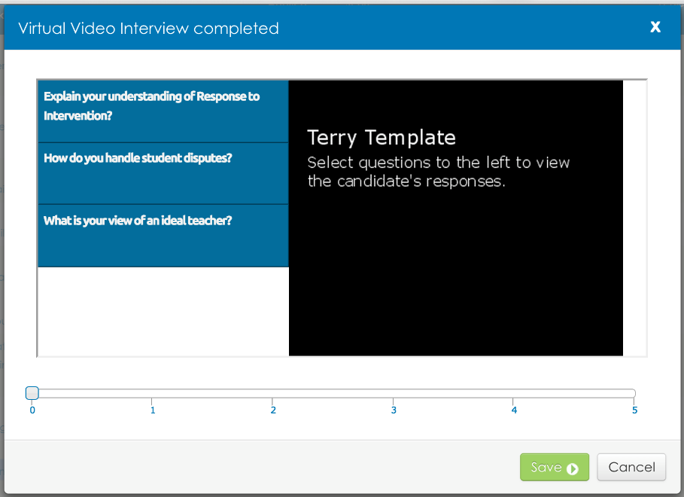
Some Additional Features Beyond Current Collaboration . . .
Virtual Video Interviewing Integrated into IntelliGlance:
Virtual Interview Status:
GREY = invitation sent but no response
RED = invitation not sent
BLUE = responses received
Virtual Interview Score
Notes:
We realized early on that the best recruiting system or screening tool is only as effective as the platform it is built on – this lead us to develop Intelliglance…a truly different, integrated, seamless applicant tracking system that:
Enables you to manage every aspect of your hiring process, from prospecting for new candidates to facilitating their on-boarding paperwork (health insurance, direct deposit forms….)
Provides you instant access to those candidates who are most promising – enabling you and your principals to schedule their interviews with a click of the mouse…
Configures over 1,800 different ways –I’ll show you how momentarily
And finally solves for a major pain point, the ability to automatically communicate with all of your applicants throughout your hiring process in a way that feels personal – yet requires no manual intervention!

Slide 10
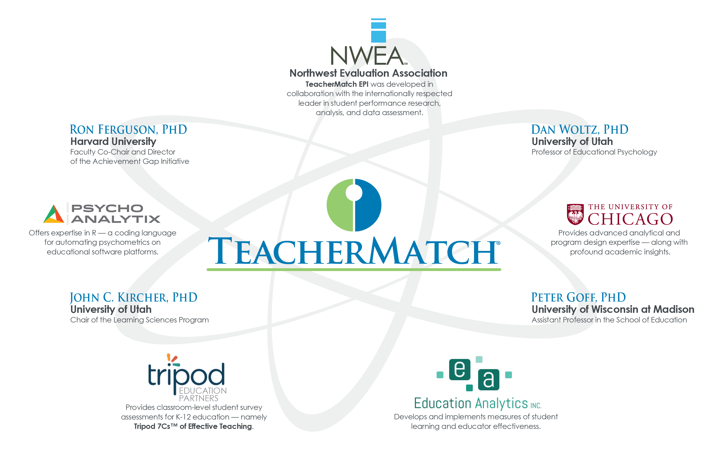
Highly Predictive Assessment. . .
The EPI Research Consortium
Notes:
Once you have maximized the quantity of applicants applying, the EPI kicks in to help you understand which of those candidates are most likely to be effective in the classroom.
Understanding who is likely to be effective at delivering academic growth and the strengths is a big, bold question!
To that end, the first thing TeacherMatch’s Founders did was form a research consortium….and at its core TeacherMatch is a university research consortium made up of four key partners:
The University of Chicago
The University of Utah
Education analytics – The University of Wisconsin School of Education and
NWEA

Slide 11
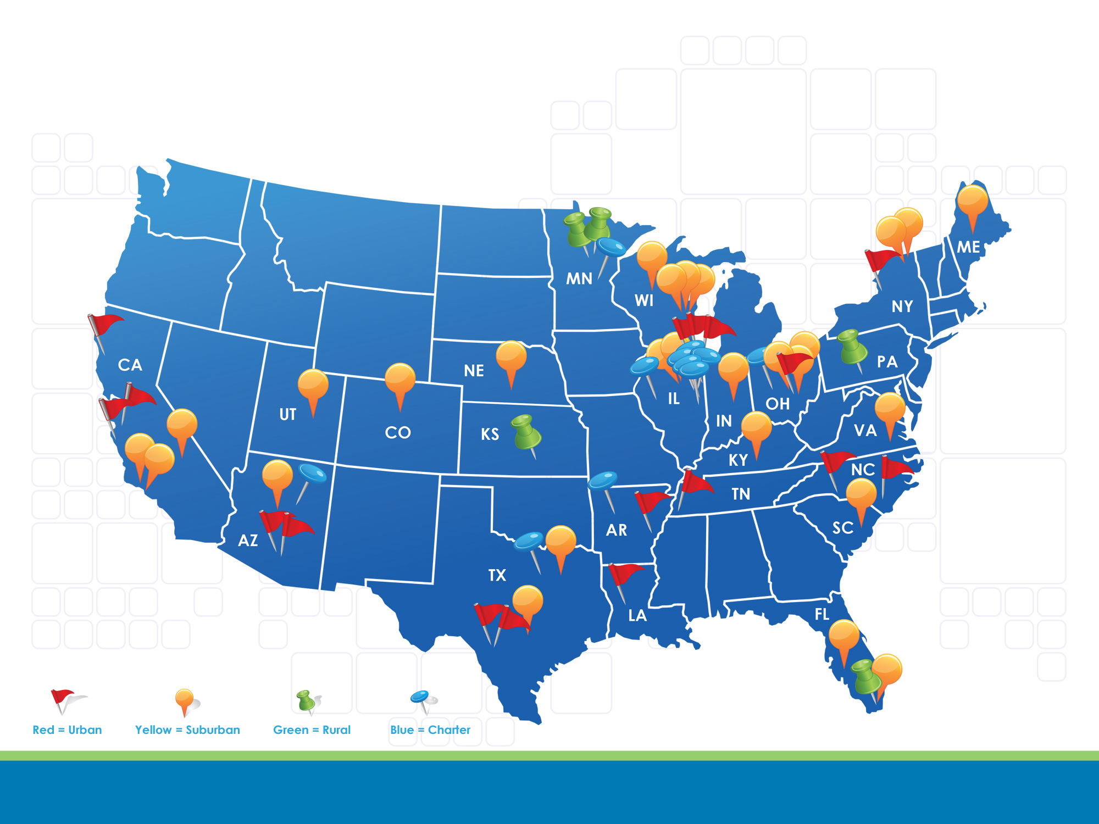
Our Nationwide Research
Sample varied by location, school type, size, and demographics.

Slide 12
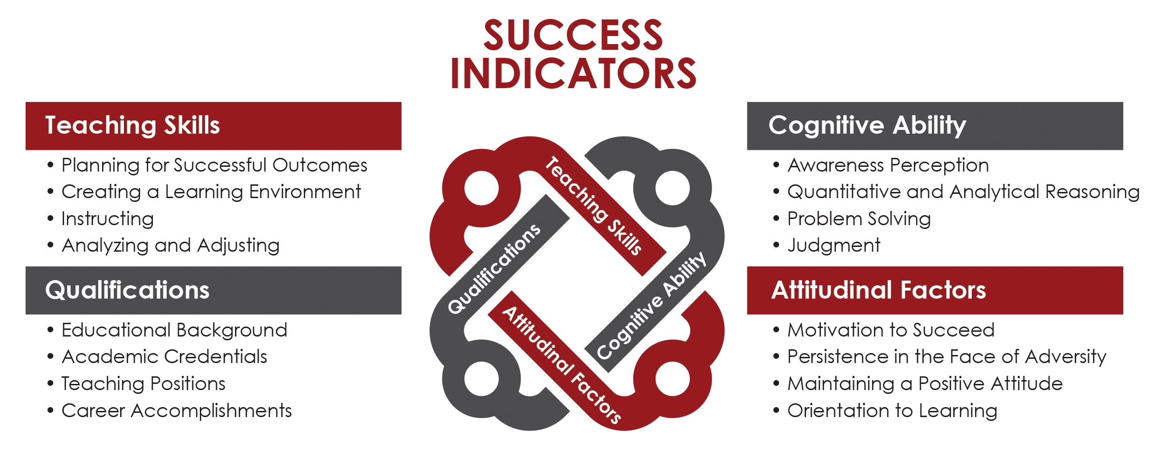
The Results of Our Research:
The Factors That Predict High-Performing Teachers
Teaching Skills
Cognitive Ability
Qualifications
Attitudinal Factors
Notes:
When the researchers began their work they were not sure that they could predict the likelihood of success….but it turns out that identifying who is likely to be effective at delivering academic growth is highly predictable……and there are four things that matter.
(Alternative: When the researchers began their work they were not sure that they could predict the likelihood of success….but it turns out that identifying who is likely to be effective at delivering academic growth is highly predictable. So unlike most hiring instruments that focus almost exclusively on “Attitudinal Factors”, the EPI provides a more complete picture of teacher effectiveness by evaluating four core Success Indicators.)
Teaching Skills
In this area we are really assessing for teachers who show an understanding and ability to engage in the following series of behaviors:
Translate a standard or concept into a form of curriculum
Deliver instruction
Create a classroom environment conducive to learning (aka classroom management)
Assess against student work
Adjust and reteach based on that student work
Understand concepts of differentiation
Cognitive Ability
In this area we are assessing whether someone has the judgment, intellect and ability to navigate the complexities of delivering effective instruction.
Attitudinal Factors
In this arena we are assessing whether an individual has the disposition to succeed in the classroom. As examples – if someone is a person of high idealism AND low grounded or perseverance they tend to struggle – as opposed to someone who has high idealism and equally high perseverance.
Another factor has to do with someone's internal reward system – those individuals needing a lot of external validation or “atta-boys” tend to not do as well as individuals internally wired for validation
Finally – the research findings have identified that those candidates who are willing to socially-emotionally engage their students drive greater academic gains from students.
Qualifications
In this final area we evaluate factors of someone's academic background that is predictive of future performance – as an example, someone's overall GPA is minimally predictive of performance, but their GPA in their credentialed area matters a lot.

Slide 13
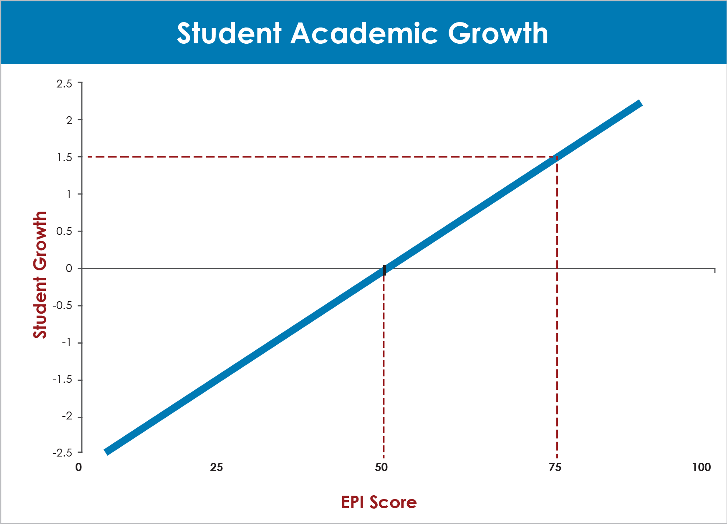
The Results of Our Research:
An instrument with the ability to predict which of your candidates
will deliver the most student growth!
Teaching Skills
Cognitive Ability
Qualifications
Attitudinal Factors
Notes:
So what does this all mean, let me walk you through the following chart created in conjunction with the University of Wisconsin:
The blue line is a candidates result on the screening instrument.
On the x-axis (horizontal) is the EPI score a candidate achieves and on the Y-axis is actual student growth achieved.
So if you track a candidate that scores 50% on the EPI, then you can predict that they are likely to achieve what an average teacher in America achieves in one academic year. So think about it as predicting one actual year of academic growth for one actual academic year – or 1 over 1.
Now lets look at candidates who score a 75% on the EPI. They are 1.5 standard deviations to the right of an average teacher – this means they are predicted to deliver an incremental three months of academic growth by their second year of teaching (ALT: it predicts that the candidate will produce more student academic growth than 93% of classrooms nationally.)
An EPI score of 35, for example, predicts the candidate is not likely to produce student academic growth at par with an average teacher in America.

Slide 14
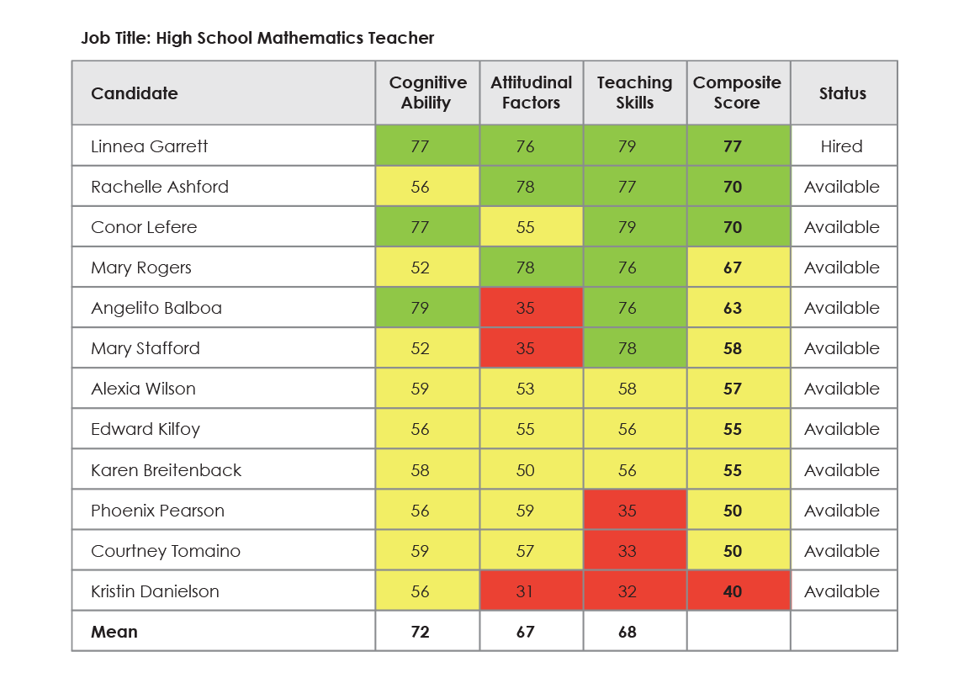
How It Works:
Quickly assess all of your new candidates —
Interview only the candidates most likely to be an effective teacher.
Notes:
How does this all work – when a candidate applies for a job posting for your district they are linked in and invited to take the EPI.
The actual instrument is 100 questions long and takes the average candidate 47 minutes to complete – although 90 minute is allotted. Once they complete the EPI, candidates are rank ordered based on their likelihood of delivering academic growth to students.
This grid provides HR and principals a roadmap to consider which candidates to interview first. Think of this grid as marrying up the art plus science of hiring. We provide the science to help understand which candidates are most likely to deliver meaningful growth to students – when married with the art of hiring – or the professional judgment of principals and HR leaders - leads to successful outcomes!
Principals love the gird as it saves them time, rather then spend hours going through resumes and determining who to interview – principals can spend that time meaningfully getting to know candidates who have been vetted as having the requisite skills and abilities to succeed in the classroom.
(A-E alphabet hiring story!)

Slide 15

What Makes Us Different . . .
One size does not fit all —
The EPI evolves over time to capture your district’s priorities!
Adaptive EPI
Notes:
The EPI is also different than anything else in the education space as it evolves over time. The TeacherMatch research team coordinates with your district to capture data and information that is critical to your district over time and then begins to customize the EPI for you. So as an example – if your district says that it wants to define success based on a combination of principal evaluation, student growth data and parents surveys – the actual platform captures that information and adapts the EPI accordingly.
So during the first year you get a highly accurate instrument that predicts teachers likely to deliver meaningful academic growth based on a nationally normed sample – by year two you get an instrument that is identifying teachers based on your districts priorities.

Slide 16
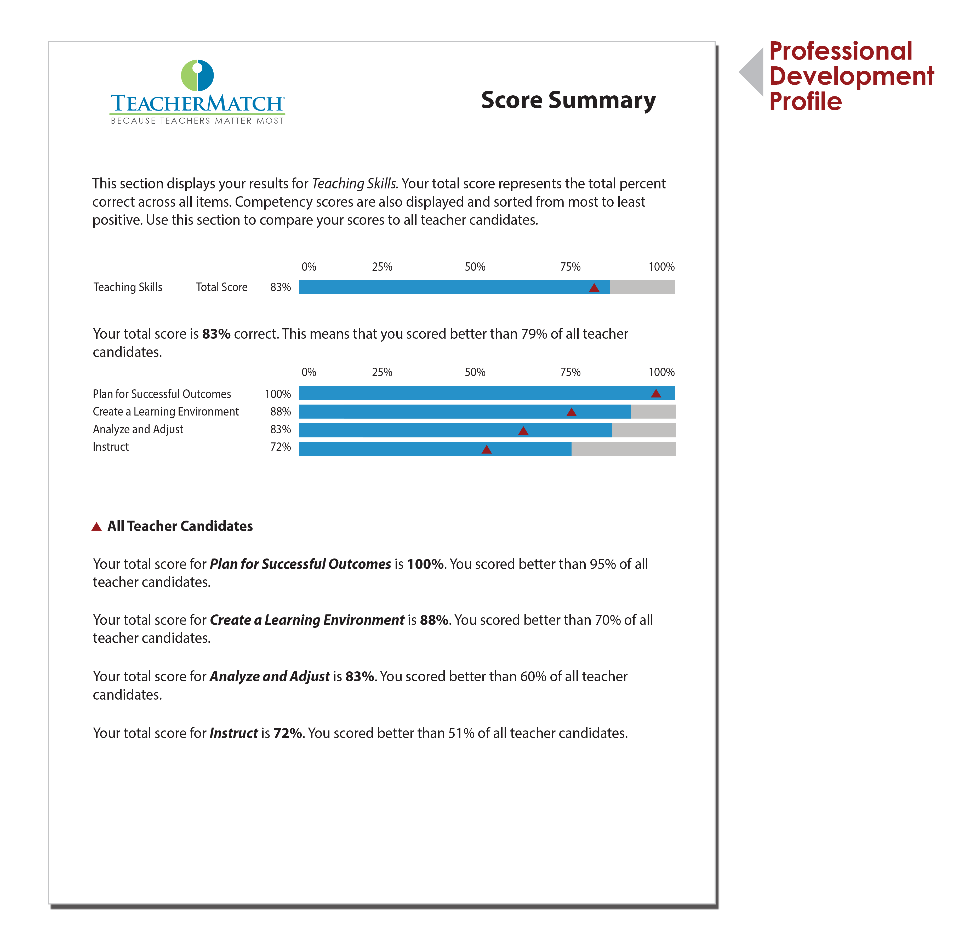
What Makes Us Different . . .
Research-based and validated EPI to hire the most effective teachers.
An evidenced-based Professional Development Profile to develop them.
Candidates you offer positions to will also receive a Professional Development Profile (PDP). Based on their EPI results, it provides specific, actionable steps they can take to advance their teaching skills and set them up for success in the classroom. It also includes a template with guidelines for preparing a customized plan that will enhance your existing PD programs.
Our toolset for new teacher induction
Use EPI results to customize PD for each new candidate
Use the district summary report to create cohorts of new teachers needing similar PD
Notes:
As you may recall, TeacherMatch was formed to not only identify who is likely to deliver meaningful academic growth – but it was also formed to help understand the strengths and weaknesses of each candidate applying to your district.
For every candidate who takes the EPI, TeacherMatch produces a 17 page customized report. This report is typically used by partner districts to help plan a new teachers professional development. Whether the report is used by a mentor, coach or the principal as the instructional leader – it provides the roadmap of development needed to help a new teacher succeed!
We also provide a district summary report to help you understand the strength and weaknesses of all of your new hires – enabling you to create cohorts of teachers needing similar PD.

Slide 17
The Result: An Advanced Education Talent Management System . . . TeacherMatch 360
Notes:
Given the problems the founders resolved to tackle, I am really excited to walk you through our platform, the TeacherMatch 360 system!
Our QUEST system helps you identify and recruit the greatest amount of candidates
The Educators Professional Inventory (or EPI) helps you assess those candidates and determine which ones will be most effective in the classroom.
The IntelliGlance Applicant Tracking system enables you to facilitate hiring those candidates in a way that is customized to the way you do business.
And finally the Professional Development Profile enables you to customize new teacher induction based on their actual strengths and weaknesses.

Slide 18

Proud to be Your Partner
For applicant tracking, onboarding, or recruiting questions or discussion, please continue to contact NCDPI.
For questions relating to the Educators Professional Inventory, video interviewing, or other items separate from our current collaboration, please contact:
Derek Lovell dlovell@teachermatch.org 864-415-5446

