Slide 1
Spring PANC
Licensure Update
April 4, 2016
Susan Ruiz
Christy Layne
Tammy Bailey

Slide 2
Discussion Items
Automatic Processes
Renewals
Conversions
Extensions
Online System Updates / Exchange of Information
Things to Remember
Feedback & Suggestions
Questions/Comments

Slide 3
Processing Automatic Transactions 2016
The renewal applications will be automatically created in the system at the beginning of the renewal window. The educator will be required to log in to their online account and complete the statement of applicant (criminal history) before the application can be approved by the school system.
Transactions will be available during the annual renewal cycle, but not before.
Note that educators with an SP2 license who are due for renewal must be renewed before you can extend a Provisional area.
Multiple applications can be approved at once. If the educator meets the requirement, the applications will be automatically approved and do not require additional processing by DPI.
Selecting too many applications to approve at one time may result is delayed system performance.

Slide 4
What the Individual Educator Will See for Renewals

Slide 5
Individual Educator – Work Authorization
If the first time accessing the online system is with an automated process the educator will be required to answer the work authorization questions.
If U.S. Citizen is selected please do not enter DOB beside Work Authorization Expiration Date.
If non-U.S. Citizen then the work authorization expiration date does need to be entered and documentation of work authorization will need to be attached under the Application Attachments tab.

Slide 6
Individual Educator – Criminal Conviction / Statement of Applicant
The online Statement of Applicant replaces the Criminal Conviction letters that were previously posted on LicSal for the LEA to print and have the educators sign.
If “Yes” to either question, the application will be automatically routed to SBE Legal for review.

Slide 7
Individual Educator – Attachments with Statement of Applicant or Non U.S. Citizen Work Authorization
Attachments will need to be uploaded if “Yes” is answered for either of the Statement of Applicant questions, or if work authorization documents exist other than U.S. Citizenship.

Slide 8
Individual Educator – Attestation
There are no fees for automatic renewals, extensions, or conversions processed online during the automatic renewal window.

Slide 9
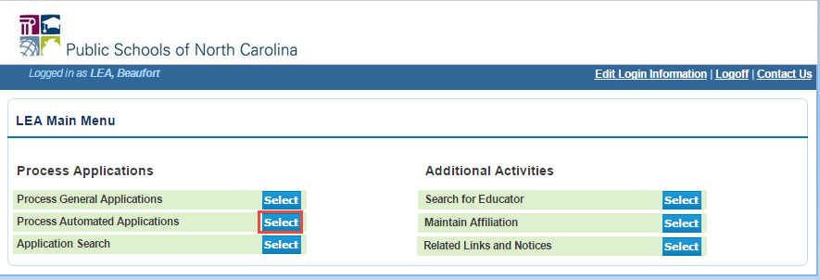
What the LEA Will See for Automated Processes
Mid April 2016 through July 2016

Slide 10
LEA - Automated Processes 2016
Click the Select button beside the list needed.
List will load, please wait for list to generate.
More than one can be processed at once.

Slide 11
LEA – Criminal Conviction / Statement of Applicant
The statement received column indicates if the educator has answered the statement of applicant questions. If the educator has not completed the statement of applicant, you will not be able to process an automated renewal on his or her behalf. The statement received column will indicate “No” and the option to select “Yes” to process the renewal is disabled and grayed out.

Slide 12
LEA – Criminal Conviction / Statement of Applicant
Once the statement of applicant is answered the option to select “Yes” to process the renewal is enabled and statement received column will indicate a “Yes.” You can now proceed with processing the renewals.

Slide 13
LEA – Processing Automatic Renewals
Select “Yes” to automatically renew
Select “No” to deny renewal – Only use if definitely not eligible for renewal
Select “Pending” if waiting for renewal criteria

Slide 14
LEA – Approved Automatic Renewals
Selecting “Yes” to renew will automatically renew the educators license
A message is displayed by each educator indicating the action taken on the license
Check the box under the print box to print the license
You can select the box for multiple educators. (Note: printing too many license at once may impact system performance.)

Slide 15
LEA – Non-Renewals
Selecting “No” will require the LEA to enter a reason for the denial
Only select “No” when you are completely certain that the educator does not meet the renewal requirements

Slide 16
LEA – Non-Renewal Comments
Comments of why the renewal is rejected are required

Slide 17
LEA – Processed Renewal Lists
Educators are removed from the renewal list once a “Yes” or “No” selection has been made and submitted

Slide 18
LEA – Renewals for “Yes” on Statement of Applicant
If the educator has answered “Yes” to one or both of the statement of applicant questions, once the LEA selects “Yes” to renewal, the above message is displayed.
Click on View Apps to see which question the educator answered “Yes” to and to see the details and attachments related to the statement of applicant questions.

Slide 19
LEA - Extensions and Conversions
Select one of the following extensions or conversions:
Extend Provisionals
S to 0 Conversions – Recommend SP1 to SP2
8 to 0 Conversions – Recommend SP1 to SP2
Please wait for full list to generate.
If multiple educators are on the list, more than one can be processed at once.

Slide 20
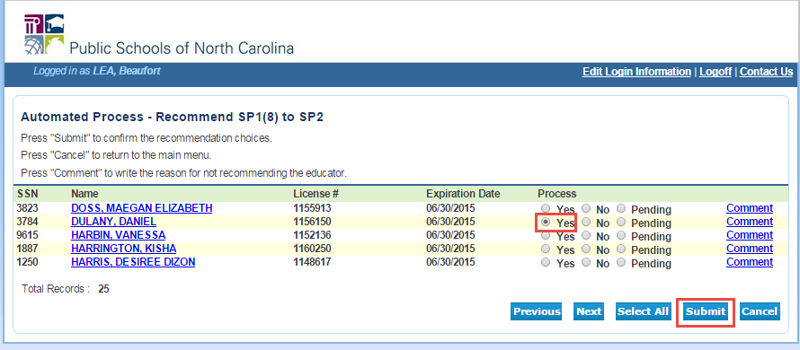
LEA – Processing Extension and Conversion Lists
Select the educator(s) from the list and click submit.

Slide 21
LEA – Processing Extension and Conversion Lists

Slide 22
Online System Updates / Exchange of Information Things to Remember Feedback and Suggestions Questions / Comments

Slide 23
Changes to Renewal Credits
SB 402, Section 9.3(f) states, “For teachers who are in their fourth or fifth year of their current five-year license renewal cycle, the changes required by G.S. 115C-296(b)(1)b., as enacted by subsections (b) and (c) of this section, shall apply beginning with the first year of their next five-year license renewal cycle.”
License Expiration Date
Renewal Requirements
5th Year – June 30, 2014
7.5 with Current Breakdown
4th Year – June 30, 2015
7.5 with Current Breakdown
Everyone – June 30, 2016
K – 8 Teachers – 8.0
3 – Content
3 - Literacy
2 - General*
All other Educators
3 – Content
5 - General*
*The General credit breakdown is subject to change based on N.C. State Board of Education policy.

