Slide 1
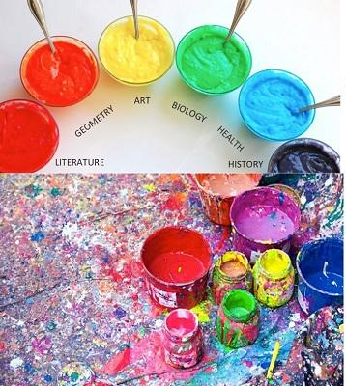
Student Teaching
Real Life
in the Classroom
Image credit: http://3.bp.blogspot.com/

Slide 2
Beginning Teacher Induction
What we do in Catawba County Schools:
Five days Summer BTI
Focus on the first 30-60 days
Differentiate by grade span and subject areas
Utilize self-assessment survey on technology to hone in on skill level
Model what we want to see in the classroom
Build in time with school-based mentor teams
Make time for the human connection and play with a purpose

Slide 3
Provide visuals new teachers can take with them to refer back to once in the classroom.

Slide 4
The Most Important Piece...
Remember what your first experience was like.

Slide 5
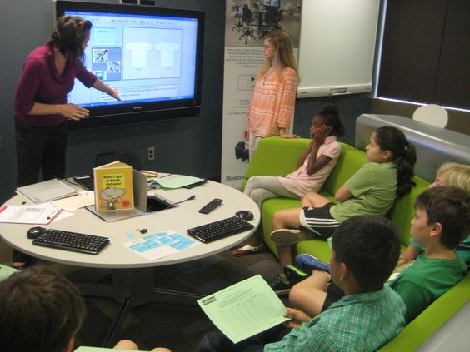
What we expect our new teachers to do...

Slide 6
How some of them think it will be...

