Slide 1
2016 FALL PANC CONFERENCE
Employee Benefits – FMLA, ADA, WC, DISability

Slide 2
Presenters
Jeff Koweek (jkoweek@wcpss.net)
Director, Employee Relations
Wake County Public Schools
Rick Johnson (rickjohnson@johnston.k12.nc.us)
Benefits Director
Johnston County Schools

Slide 3
EMPLOYEE BENEFITS
Suggested approach:
- When employees need their benefits, they are vulnerable and may be scared.
We administrators are representatives of our school system.
- Our compassion, patience, and understanding means a lot.

Slide 4
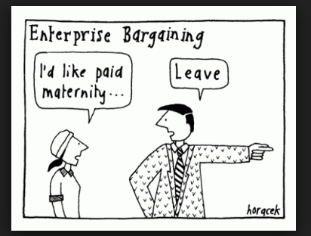
FMLA: a nice benefit….

Slide 5
FMLA
Family Medical Leave Act (FMLA) – State Employees Benefits Manual Sect 8.2 and 29 CFR 825
        is an entitlement for eligible employees for 12 weeks or 60 days or 480 hours of JOB PROTECTED leave
- does not provide paid time off (it is not paid leave)
- runs concurrently with any paid leave that comes from being a state employee

Slide 6
FMLA
Family Medical Leave Act (FMLA) – State Employees Benefits Manual Sect 8.2 and 29 CFR 825
- can be used for continuous, intermittent, and/or reduced schedule leaves
- can refresh year to year if eligibility requirements are met
has special protections to help immediate family members in the military

Slide 7
FMLA
FMLA - (federal entitlement) – job protection
----------------------------------------------------------------------
PAID LEAVE - (state benefits) – sick days, annual leave, etc.
-----------------------------------------------------------------------------------------------------

Slide 8
FMLA
Suggestions:
Provide training for leave processors
Require leave processors to send an email to HR whenever an employee is out more than three days or a chronic condition is known. (5 business day requirement)
For intermittent FMLA, have employee write FMLA on the leave form to distinguish FMLA from ordinary leave
Post leave related forms online for easy employee access

Slide 9
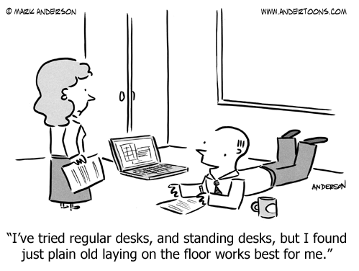
ADA - A Reasonable Accommodation?

Slide 10
ADA – Americans w/Disabilities ACT
42 U.S.C. § 12101
From US Dept. of Labor website:
A job accommodation is a reasonable adjustment to a job or work environment that makes it possible for an individual with a disability to perform job duties. Determining whether to provide accommodations involves considering the required job tasks, the functional limitations of the person doing the job, the level of hardship to the employer, and other issues. Accommodations may include specialized equipment, facility modifications, adjustments to work schedules or job duties, as well as a whole range of other creative solutions.

Slide 11
ADA - Scenarios
Two employees show up at work. Each announces that s/he has medical restrictions, but is present and ready to work. What is your advice/process?
1) Employee must use assisted-mobility device, cannot lift more than ten pounds, and is restricted from bending or squatting
2) Employee is recommended to take a break for ten minutes out of every hour to take medication and rest before resuming duties.

Slide 12
ADA
Suggestions:
Create a form that is accessible online for people to fill out
Better if HR runs review, and acts as a mediator
Think win-win
Engage in an interactive process
Focus on details - every situation is unique.
Endeavor for consistent results

Slide 13
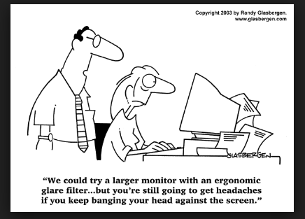
ADA –know the facts!

Slide 14
EXPRESSING BREAST MILK AT WORK
The Affordable Care Act also mandates that employers are required to provide reasonable break time for an employee to express breast milk for her nursing child for one year after the child’s birth each time such employee has need to express milk. The employer is not required to compensate an employee receiving reasonable break time for any work time spent for such purpose. The employer must also provide a place, other than a bathroom, for the employee to express breast milk.
In NC, employers must provide reasonable accommodations, and a private (locked) space that is not a bathroom.

Slide 15
EXPRESSING BREAST MILK AT WORK
SCENARIO:
A teacher returns from Leave for New Parents and insists that her schedule to express breast milk is inflexible. A doctor writes a note stating it is medically necessary that she pumps at set times which would prevent her from doing morning supervision duty and take her out of class for 20-30 minutes every day.
How do you advise the principal who calls you for advice?

Slide 16
EXPRESSING BREAST MILK AT WORK
Suggestions:
Treat issue as an accommodation request
Do a deep dive into the individual employee’s schedule
Have administrator engage in interactive approach
Instructional time should be preserved
“Let’s see how proposed schedule works before making a final decision”

Slide 17
General Advice for FMLA, ADA requests
Meet with people and engage in the interactive process.
      Support your principals/supervisors with medical issues
Train supervisors never to call behind doctor's notes and that there is a difference between absences and excessive absences
Separate medical vs. performance
Post medical forms and information online so that they are accessible
Train leave processors that HR should be notified whenever someone is out for 3 or more days or when there is a chronic, ongoing condition

Slide 18
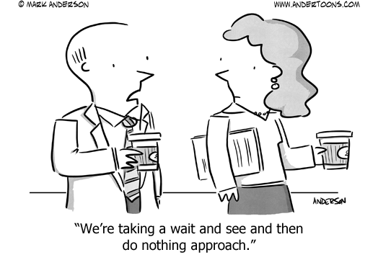
Patience: a virtue for ADA requests?

Slide 19
Interplay of FMLA with Workers’ Comp and Short Term Disability
FMLA Eligibility
Short – Term Disability Eligibility
Workers’ Comp - Eligibility

Slide 20
FMLA Eligibility
Employed one year
1250 hours
Personal serious medical condition
Serious medical condition of an immediate family member
Military exigency
Only employees’ own medical condition coordinates with short-term or workers’ comp

Slide 21
FMLA Eligibility cont.
Eligibility Periods
  Calendar Year
  Fixed 12-month “leave Year”
    Fiscal year
    Academic year
    Employee’s “anniversary” date
  12-month period measured forward from the date any employee’s first FMLA leave begins
  “Rolling” 12 month period measured backward from the date an employee uses any FMLA leave

Slide 22
FMLA scenario
A teacher suffers from a chronic condition that requires she periodically be out for treatment.
The employee has been employed for 10 months
Is the teacher eligible for FMLA?
Why or why not?

Slide 23
Short-term Disability Eligibility
One year of “contributing membership” service within the last 36 calendar months
Disability must have occurred while in pay status active employed/using leave
  exceptions between terms or on workers’ comp
  inability to perform duties of the position individual was hired to do
60 day waiting period –
  Extended Sick Leave or Voluntary Shared Leave can be used during WP
Health Insurance – paid by employer only if employee has at least 5 years of “contributing membership service”
Under FMLA – health insurance is paid by employer for 12 weeks even if less that 5 years of service
Employee pays after 12 weeks FMLA ends IF they have been employed less than 5 years

Slide 24
Short-term Disability cont
Continues to receive credit towards retirement
May be eligible for benefits beyond the short-term period
  Extended short-term disability
  Long-term disability
  Retirement
Eligibility for other benefits
  Death Benefit
  Survivor’s Alternate Benefit

Slide 25
Workers’ Compensation
All employers in North Carolina must provide coverage (3 or more employees)
Provides benefits for work related injuries
Disability must arise out of the course of employment
  Injury by accident
  Occupational illness

Slide 26
Scenario:
A custodian injures his knee. He has been employed 20 years. His Doctor writes him out of work for 4 months pending surgery and rehabilitation
What should you consider in determining whether the employee is eligible for FMLA?
Should the employee be notified that his time out of work will be considered FMLA?

Slide 27
Scenario, cont’d
The injury for the was in the course of employment. It is determined by the adjuster that the injury is covered by for workers’ comp
How would this affect the way you handle the case?

Slide 28
Scenario, cont’d
Employee’s rehabilitation takes longer than expected. Employee’s doctor says he will be out of work for an additional 3 months
What would you do?

Slide 29
Best Practices
First determine benefits under Workers’ Comp and/or Short-term Disability
Always coordinate FMLA with Short-term Disability and/or Workers’ Comp
Notice requirements
Time table

Slide 30
Why Coordinate FMLA?
Employees are entitled to all rights afforded under each applicable law
FMLA provides “Job Protection” for up to 12 weeks (includes health insurance)
Workers’ comp provides medical treatment and weekly compensation (may include health insurance)
Short-term disability provides income replacement and protection of benefits
  Health Insurance
  Death Benefits
  Retirement

Slide 31
Group DISCUSSION
Get together in groups of 4-6 people
At least 2 people should not be from the same LEA
Discuss at least 2 scenarios focusing on:
      Information you need to know
      Employee rights and responsibilities
      Employer rights and responsibilities

Slide 32
Scenarios (A)
A new principal reports that a teacher expresses a need to be out for a month before the baby comes. The principal reports of the need to have the teacher out as little as possible because a Board member's child is in the class. The teacher has asked to use paid leave before FMLA leave.
What questions do you have for the principal? What are the employee rights and responsibilities associated with this situation?

Slide 33
Scenarios (B)
A custodian was out of work for 6 months on workers’ comp .
He has been back at work for 6 months and is diagnosed with a medical condition unrelated to his workers’ comp injury.
He will be out of work for 4 weeks.
What benefits might the employee entitled to receive?
If the employer failed to designate his absence resulting from the work related injury as FMLA, how does this affect the employee’s eligibility?

Slide 34
Scenarios (C)
A first year teacher on the 2nd day of the school year does not show up for work. When the Asst Principal speaks to her the next day, she says that she can only work half days for the next two months due to a pre-existing medical condition. A legitimate doctor's note supports this.
What are the employee's rights in this situation?
What if the medical condition was a pre-existing condition not disclosed on the required health form?

Slide 35
Scenarios (D)
A Teacher Assistant injures ankle when she trips while walking on the sidewalk
Her doctor writes her out of work pending ortho referral.
It is two weeks before she can be seen by ortho
After her ortho appointment she is released to full duty without restrictions
To what benefits might she be entitled?
What steps should you take in determining these benefits?
Give a time line of all notices you would provide to the employee.

Slide 36
Scenarios (E)
A tenured teacher, out on disability the prior year, has been cleared by her doctor to return. The principal has concerns about the teacher's ability to perform general job functions (copying, circulating in the classroom). The teacher now cannot seem to stop crying, asking others for help, and publicly expressing frustration and irritation. The principal shares that he is besieged with requests to move students out of this class. You met with the teacher and believe it will be difficult for this teacher to be effective in front of students.
What employee rights and responsibilities are associated with this situation? What advice can you offer?

Slide 37
Scenarios (F)
A maintenance worker has worked for your LEA for 6 years.
The employee is involved in a non-work related motor vehicle accident and suffers severe injuries.
His doctor states that it will be 6 months before he can return to work.
How would you handle this employee’s situation?
What benefits is he eligible to receive?

Slide 38
SCENARIO WRAP-UP
When assessing applicability of employee benefits, make sure you have all the relevant information:
WHO (employee’s position, length of employment, job status)
WHAT (injury/illness facts, job duties)
WHERE (injury/illness facts, at work or not)
WHEN (injury/illness facts, while an employee or not)
HOW LONG (injury /illness facts, time period needed)
WHY (background information, supervisor/employee intent)

Slide 39
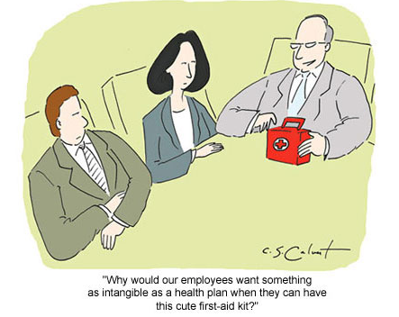
ALWAYS keep it real

