Slide 1
Employee Wellness in the World of Stress
Eric Davis

Slide 2
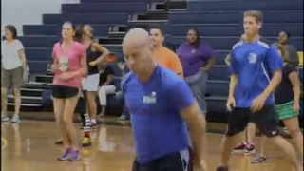
Interval Training
Warm up

Slide 3
What is Employee Wellness?

Slide 4
Psychological Safety
Positive School Climate
Personal Fitness

Slide 5
Happy Teachers Make Happy Students

Slide 6
Think about it …
=
It takes 12 positive experiences to make up for one unresolved negative experience.

Slide 7
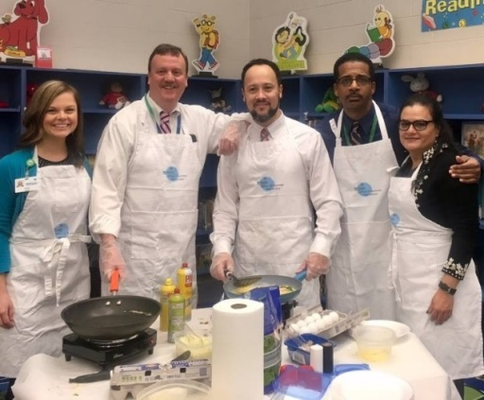
Finding Opportunities to Celebrate and Recognize Staff Members
Gratitours
#AwesomeEducatorOfTheWeek
Weekly “Shout Outs”
“Why I Teach”

Slide 8
Promoting Personal Fitness

Slide 9
Research-Based
When staff members feel good about themselves, they are more productive and engaged at work.

Slide 10
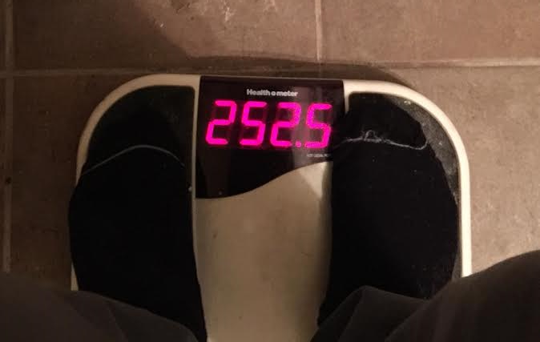

Slide 11
Top 10 Benefits Of A Workplace Wellness Program
Fun
Improved Productivity
Happier
Lower Health Care Costs
Builds Community
Sense Of Accomplishment
Improved Physical Fitness
Weight Loss
Less Stress
Healthier Habits
Health Fitness Revolution – July 2016

Slide 12
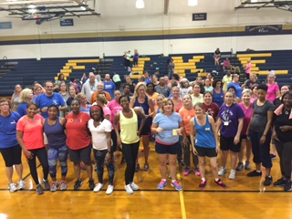
Wellness Kickoff

Slide 13
Establishing
Goals for the Year

Slide 14
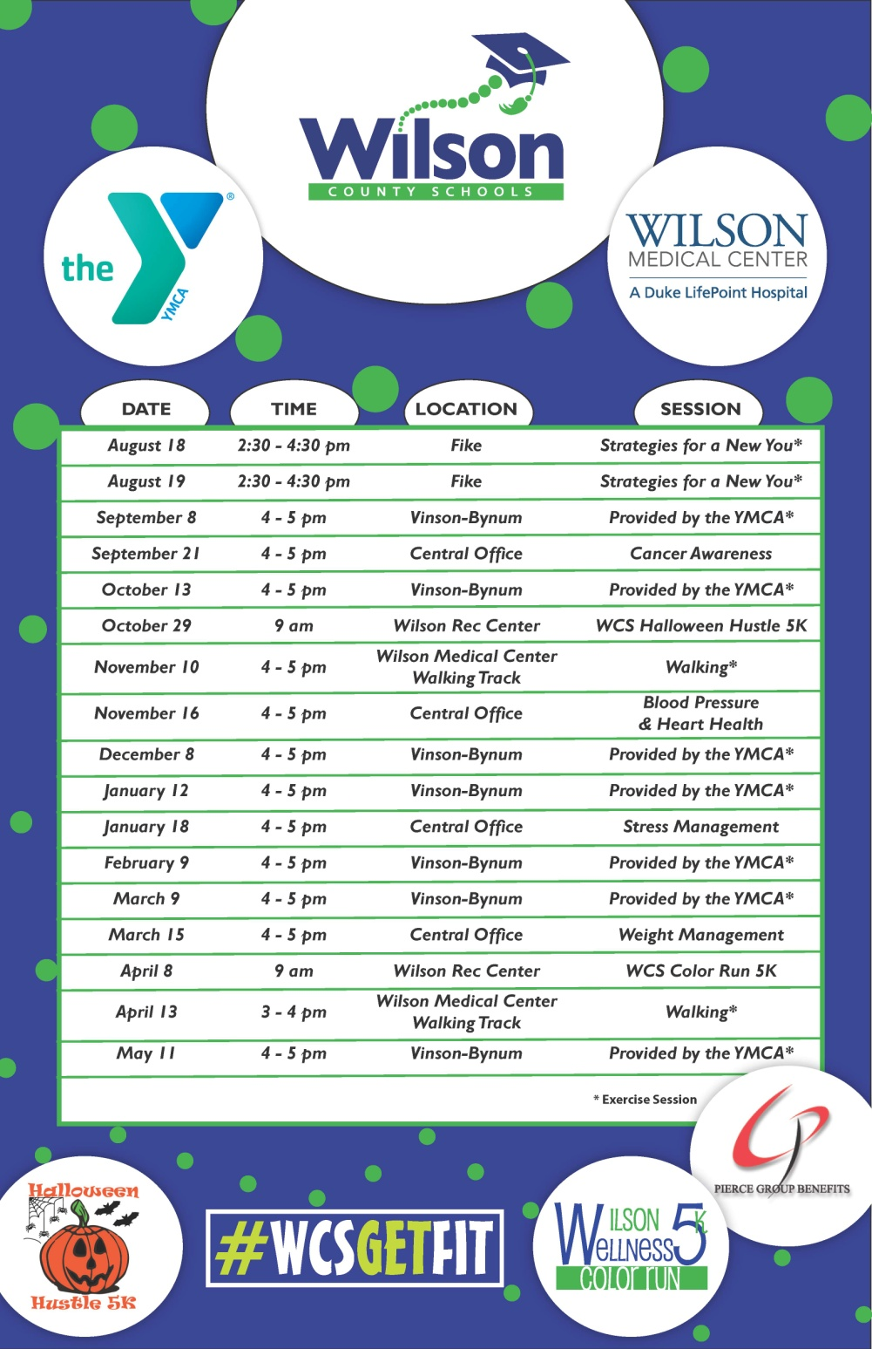
Comprehensive Calendar of Wellness Events
Monthly Fitness Workouts
Health and Wellness Sessions
Community Events

Slide 15
Community Events

Slide 16
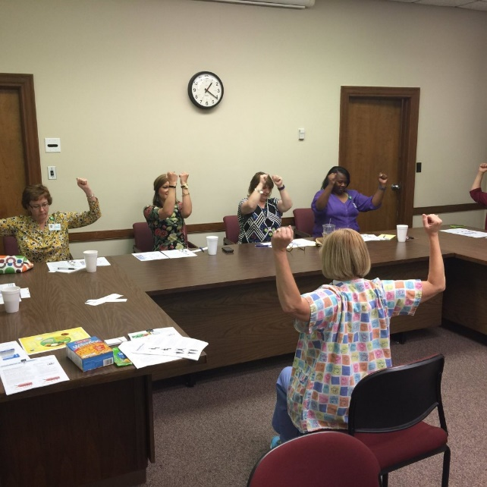
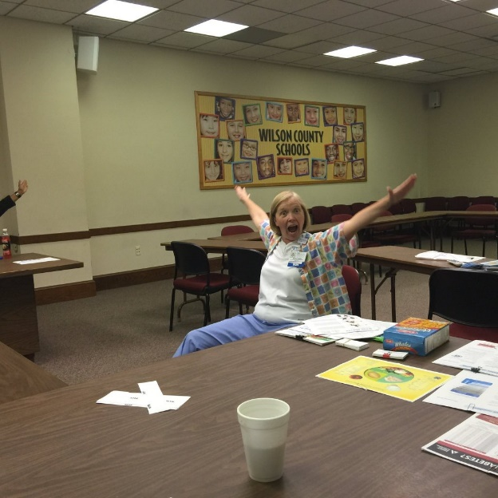
Wellness Sessions

Slide 17
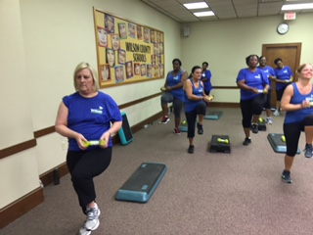
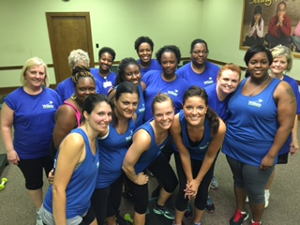
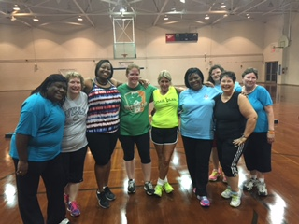
Monthly Fitness Classes

Slide 18
Workout Videos
Workout Video
Channel 22

Slide 19
Community Fitbit Group

Slide 20
Monthly Motivation
“Our Story”
"What I would like to tell others who are considering losing weight or becoming healthier is YOU ARE WORTH IT! I feel so much better, my health is great and I love buying new clothes! Make yourself a priority! You'll be so glad that you did!"
Georgia Vick
Kindergarten Teacher at Wells ES
Lost 75 Pounds

Slide 21
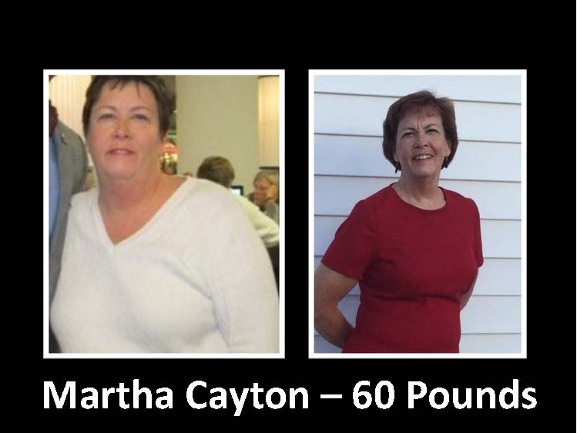
Inspiration

Slide 22
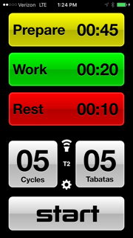
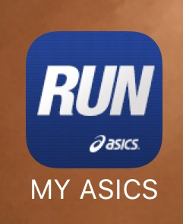
Personal Fitness Apps

Slide 23
#WCSGETFIT
Questions
eric.davis@wilsoncountyschoolsnc.net

